Slide 1
2011 Conaway conference
Construction photos 2010

Slide 2
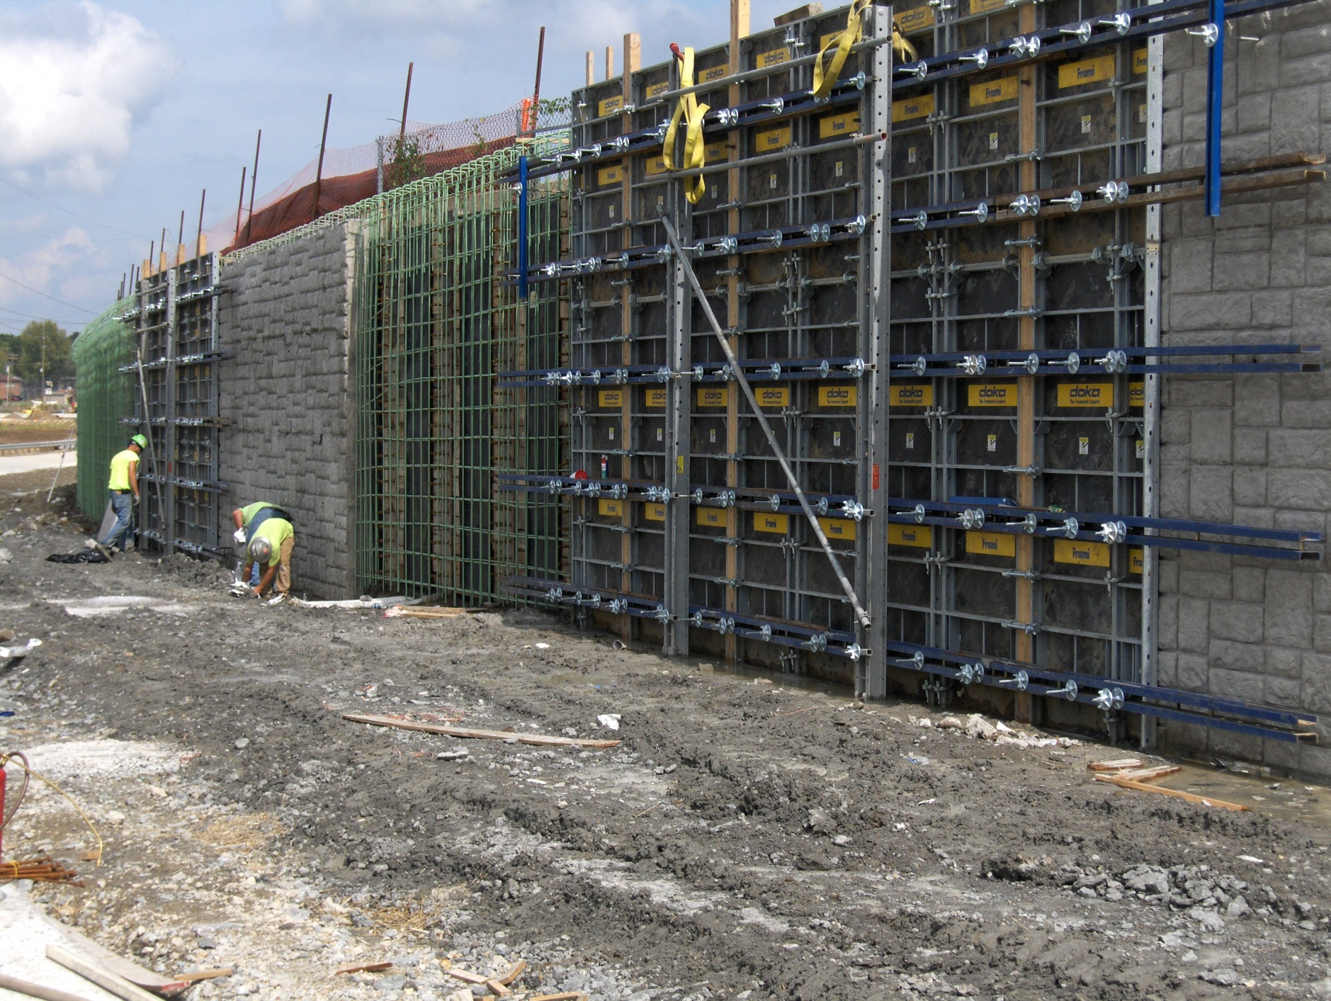
WAR IR-75 003.40

Slide 3
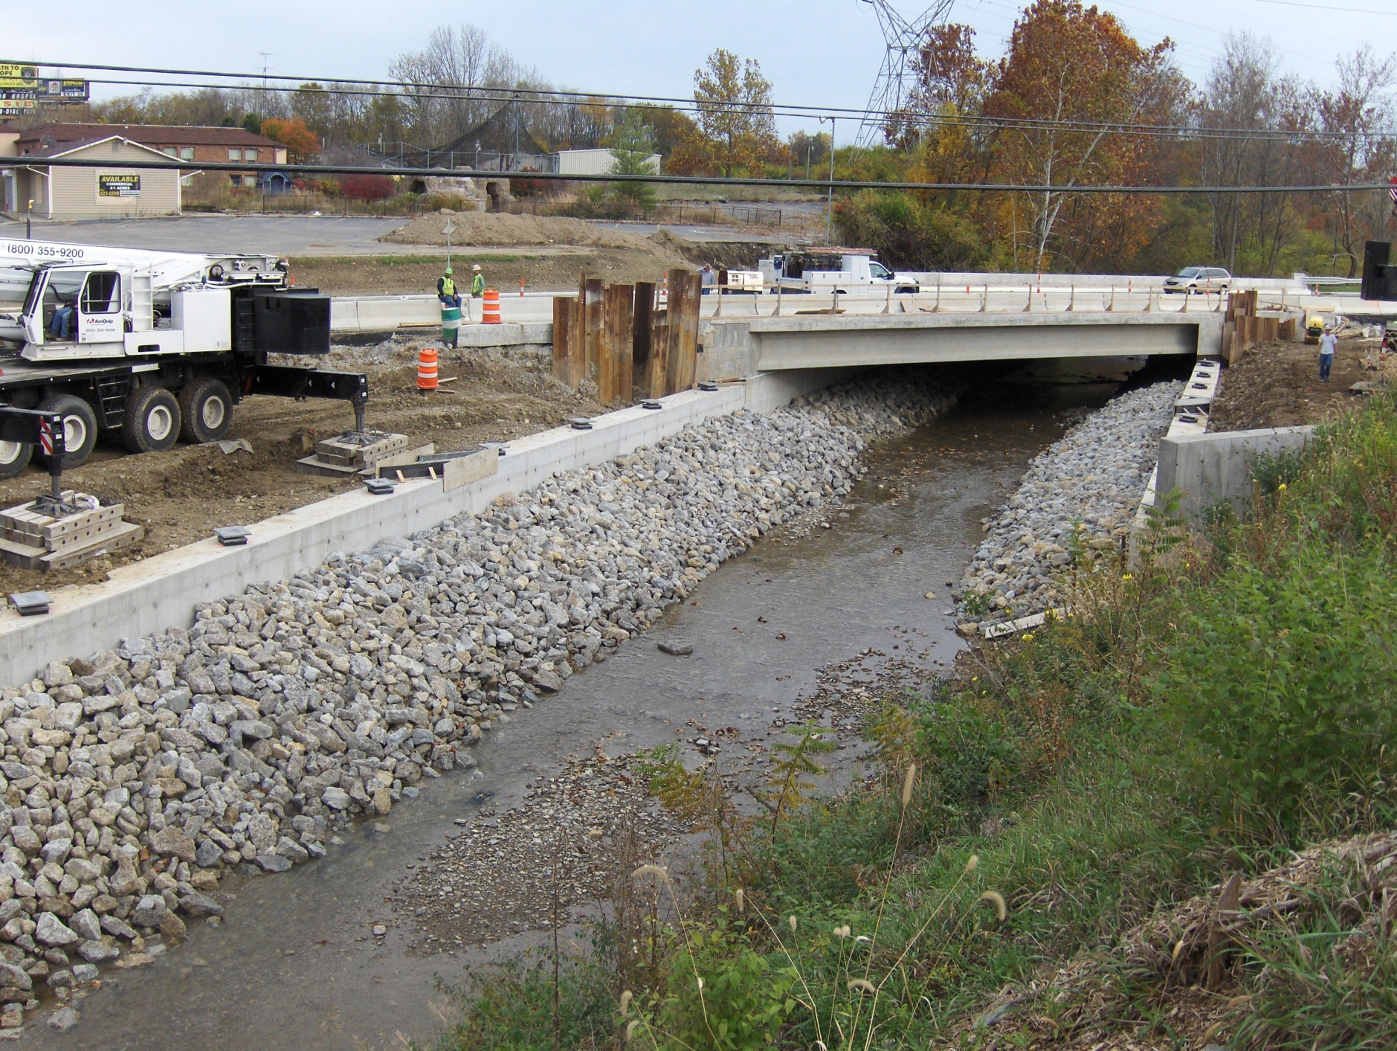
WAR IR-75 003.40

Slide 4
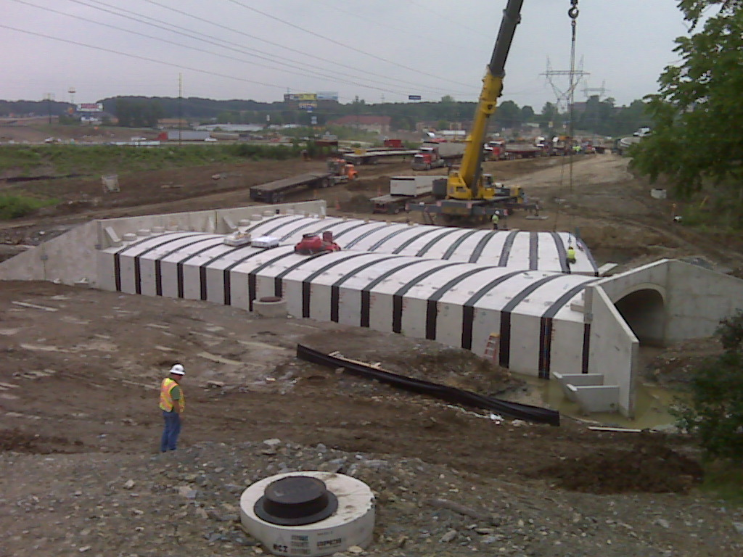
WAR IR-75 003.40

Slide 5
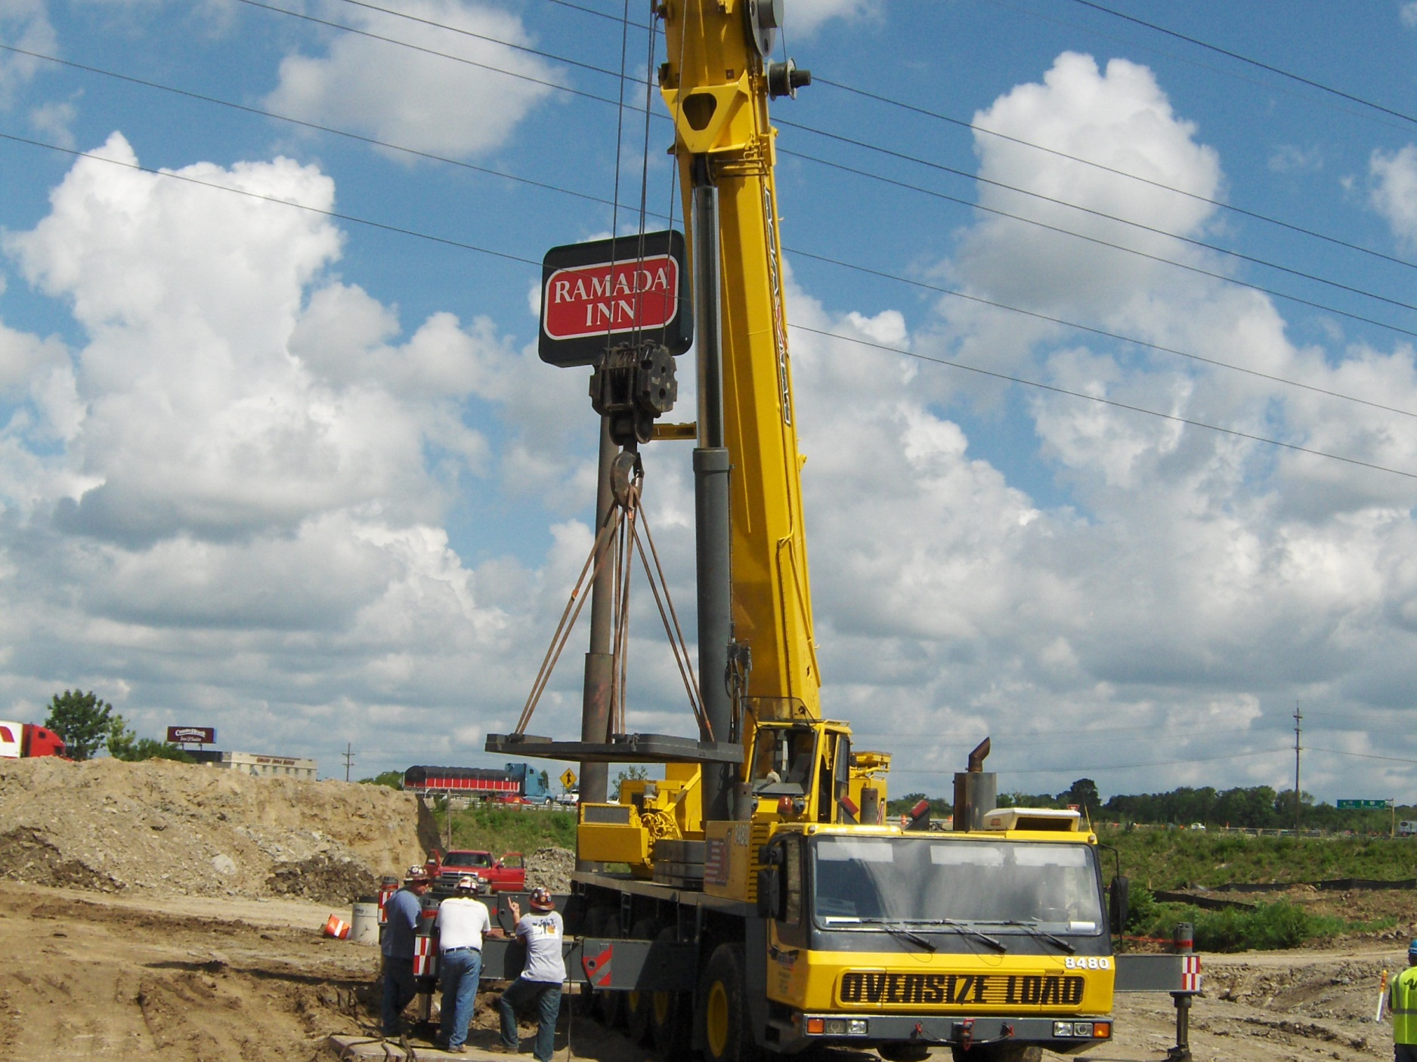
WAR IR-75 003.40

Slide 6
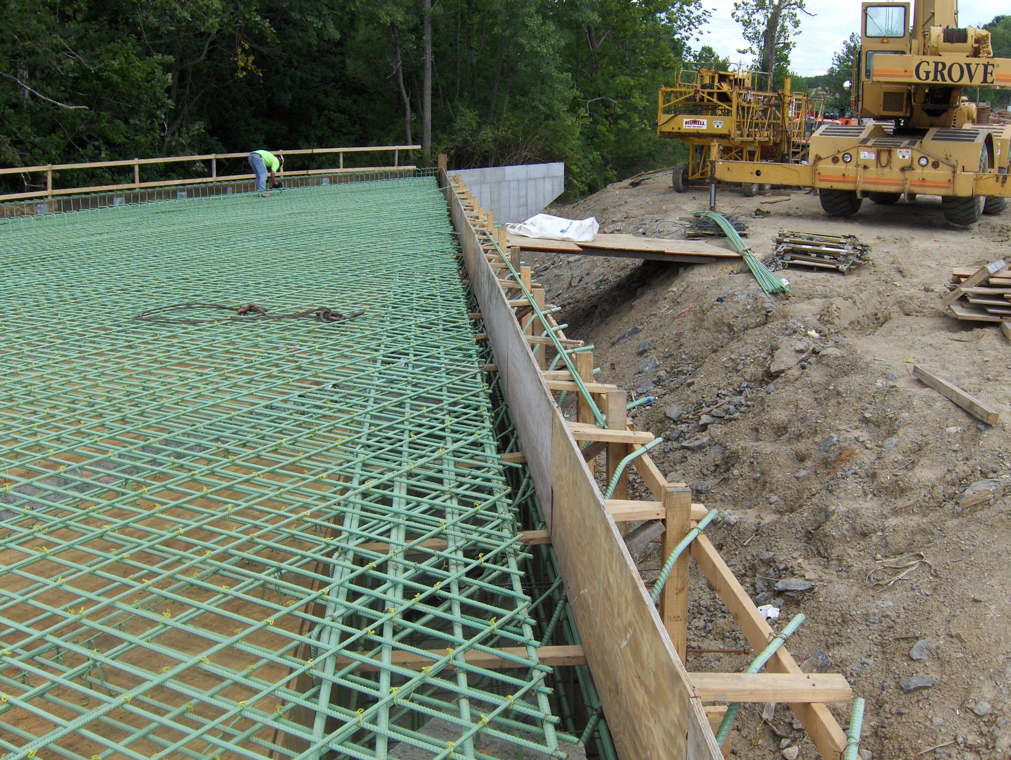
WAR IR-75 003.40

Slide 7
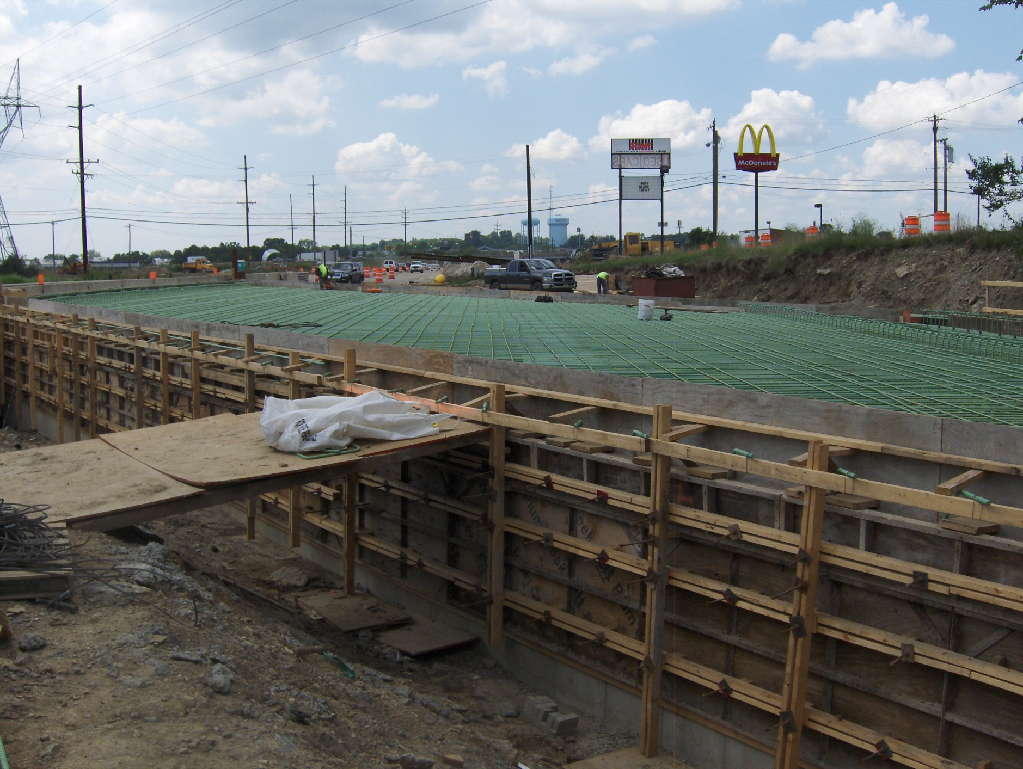
WAR IR-75 003.40

Slide 8
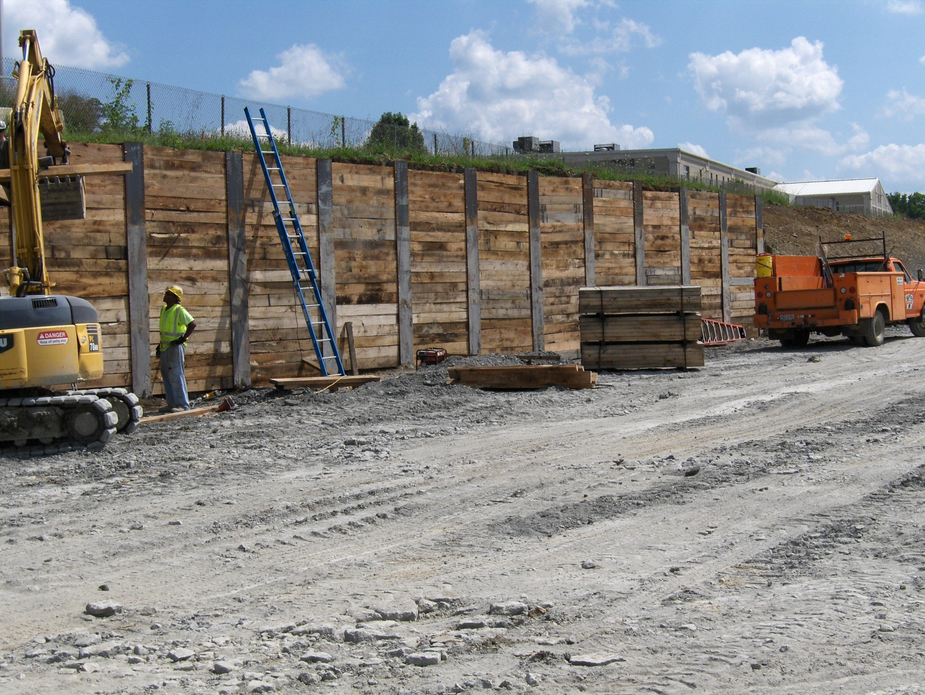
WAR IR-75 003.40

Slide 9
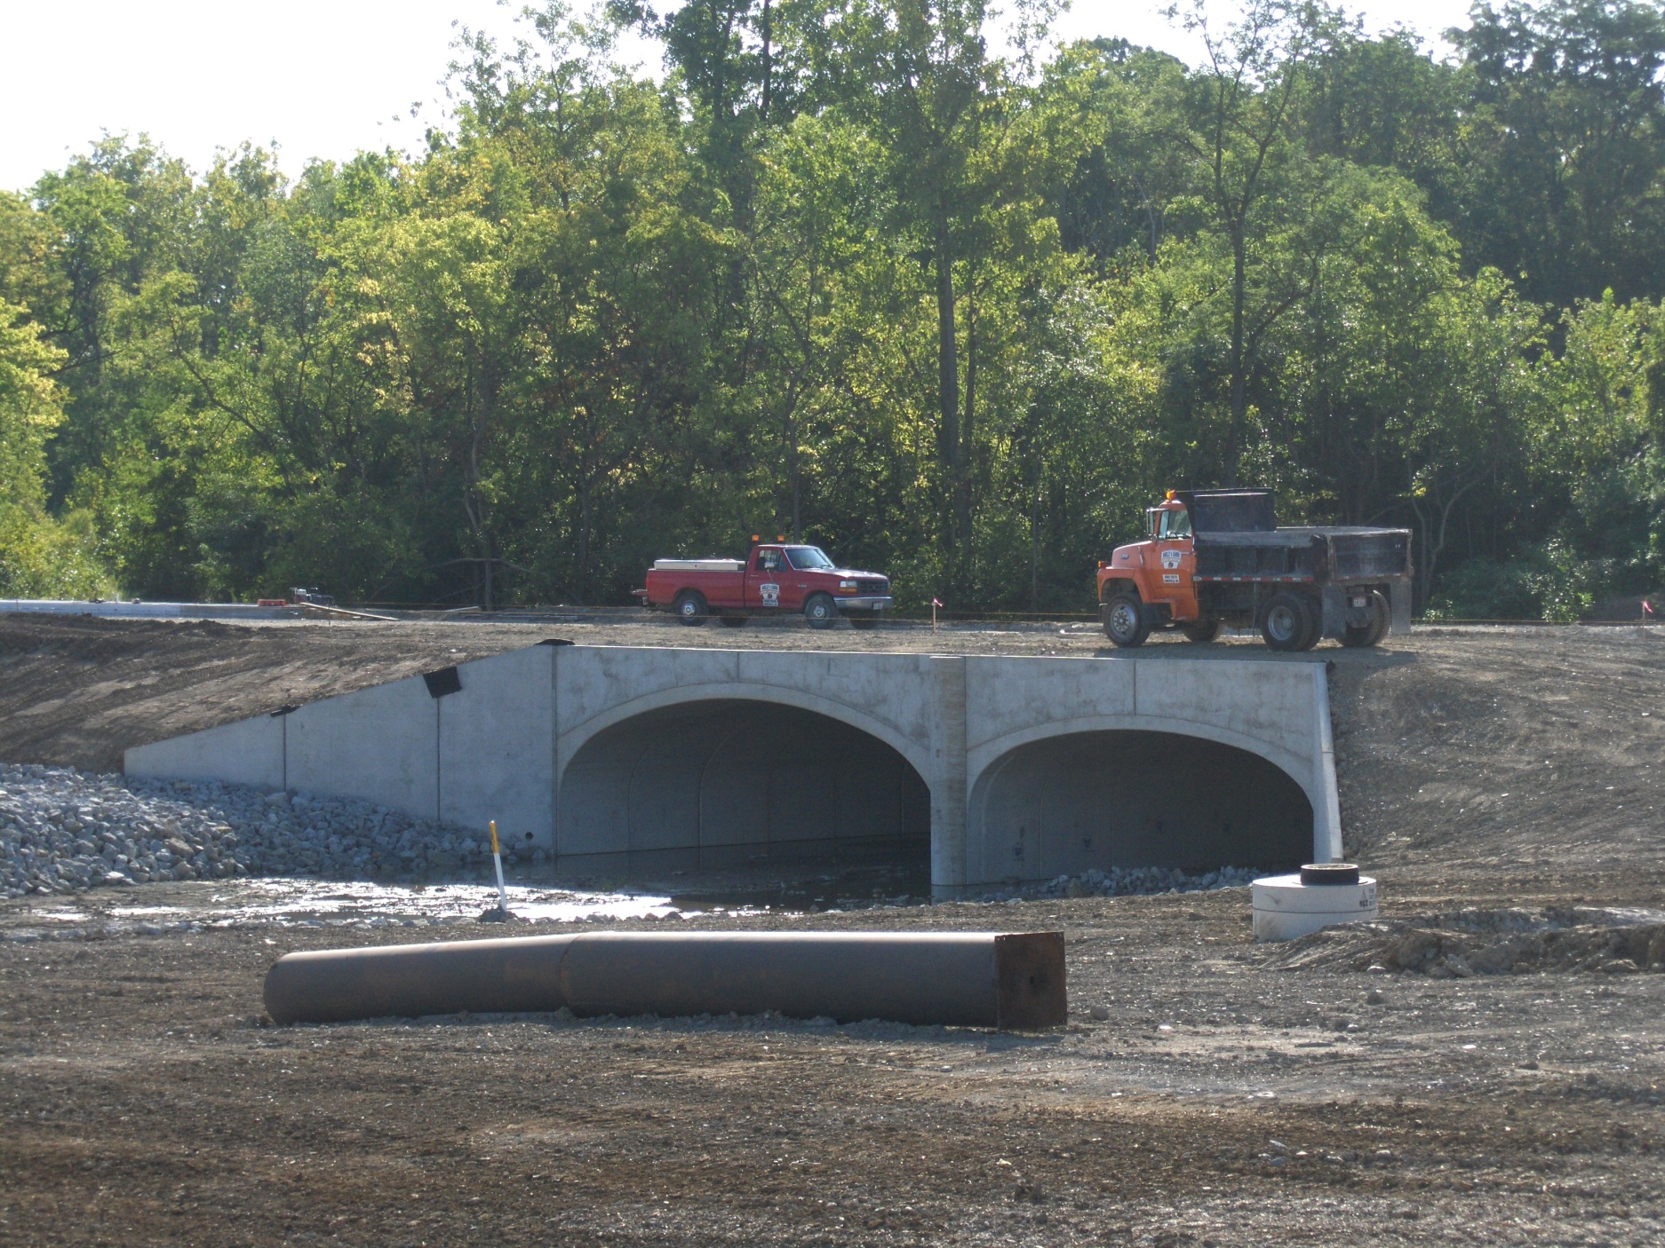
WAR IR-75 003.40

Slide 10
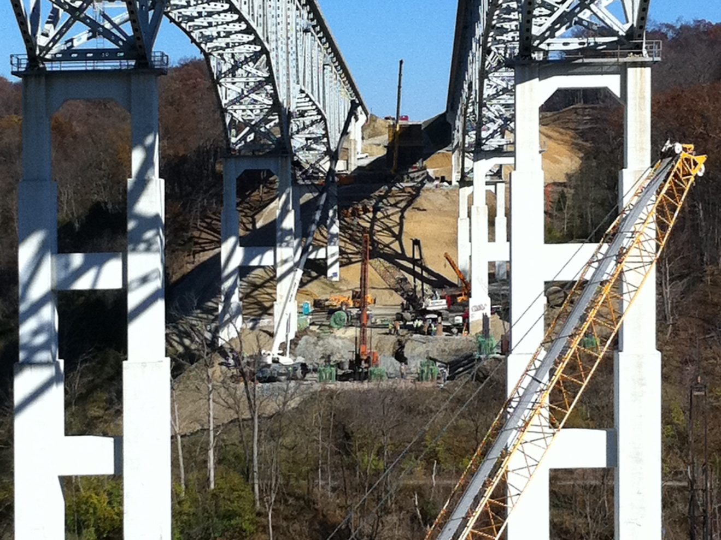
WAR IR-71 014.20

Slide 11
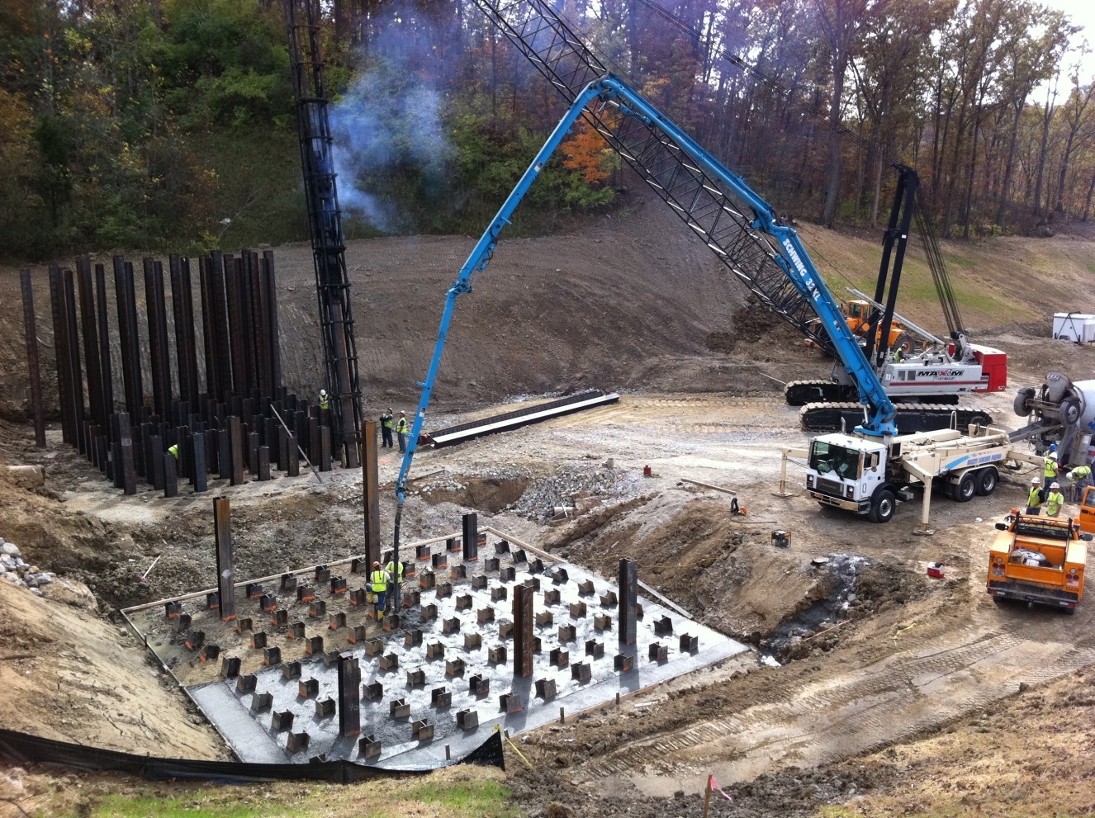
WAR IR-71 014.20

Slide 12
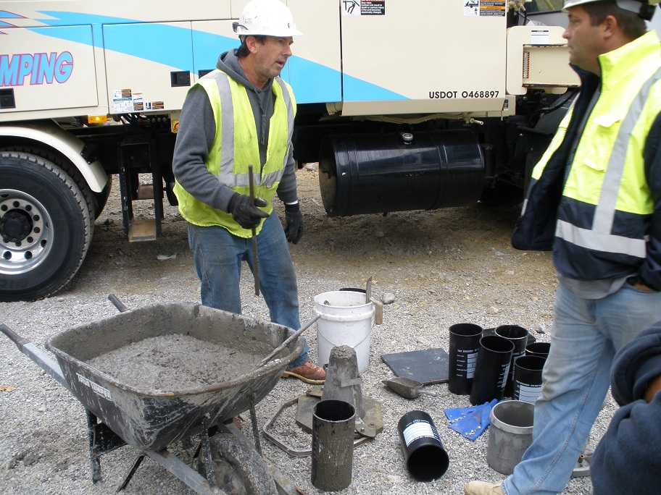
WAR IR-71 014.20

Slide 13
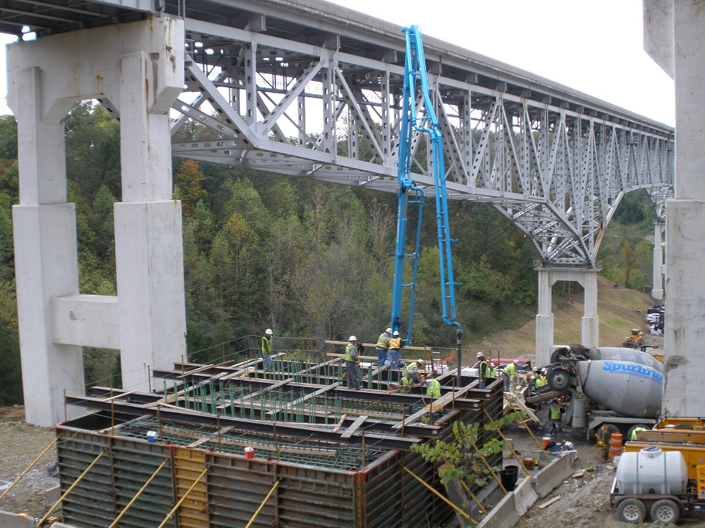
WAR IR-71 014.20

Slide 14
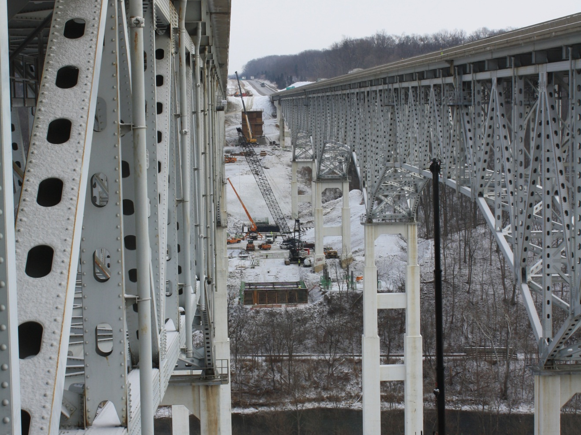
WAR IR-71 014.20

Slide 15
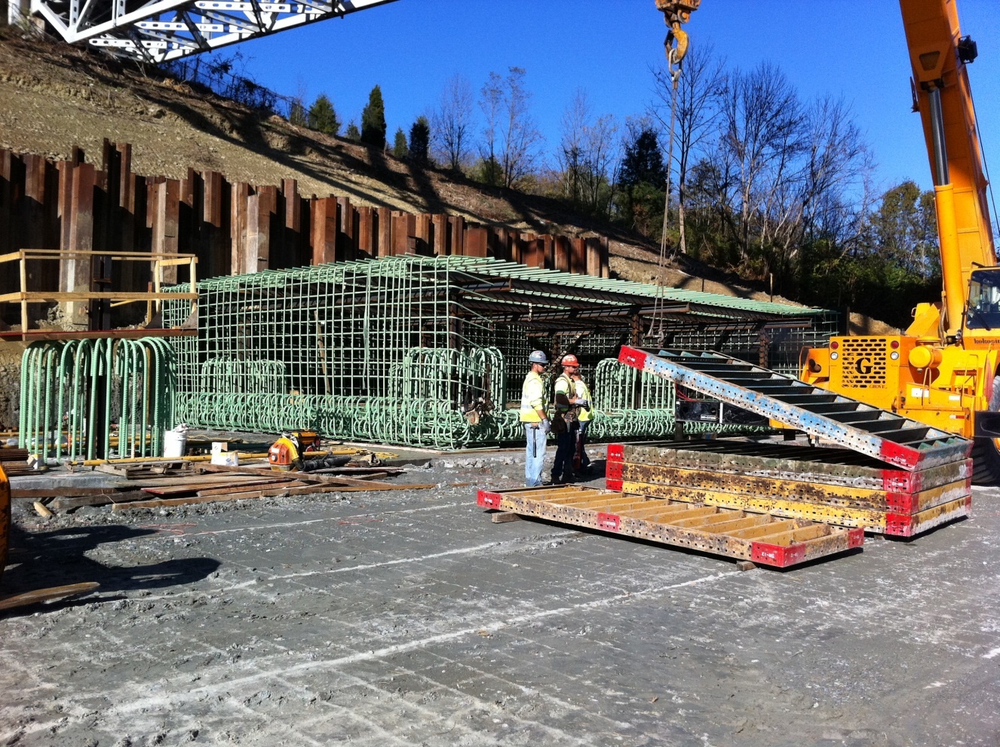
WAR IR-71 014.20

Slide 16
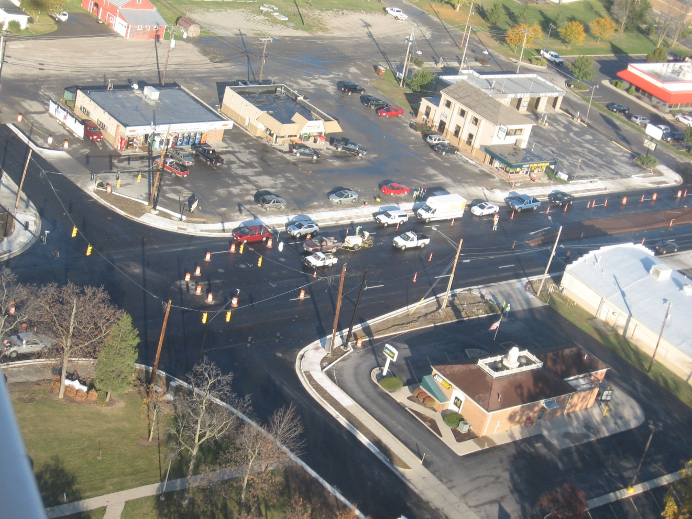
DEF-66-7.37

Slide 17
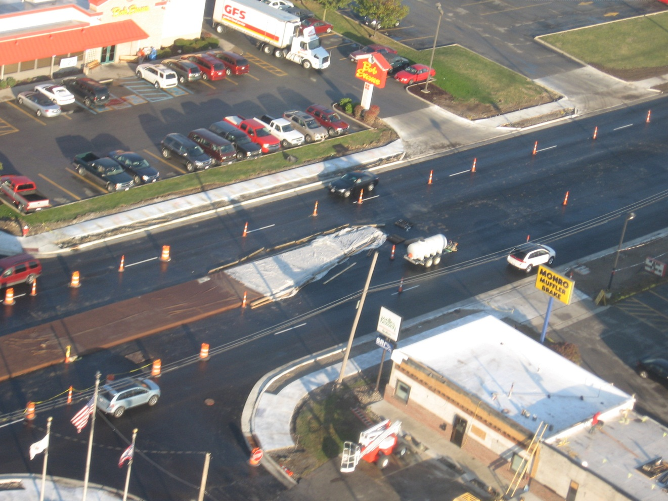
DEF-66-7.37

Slide 18
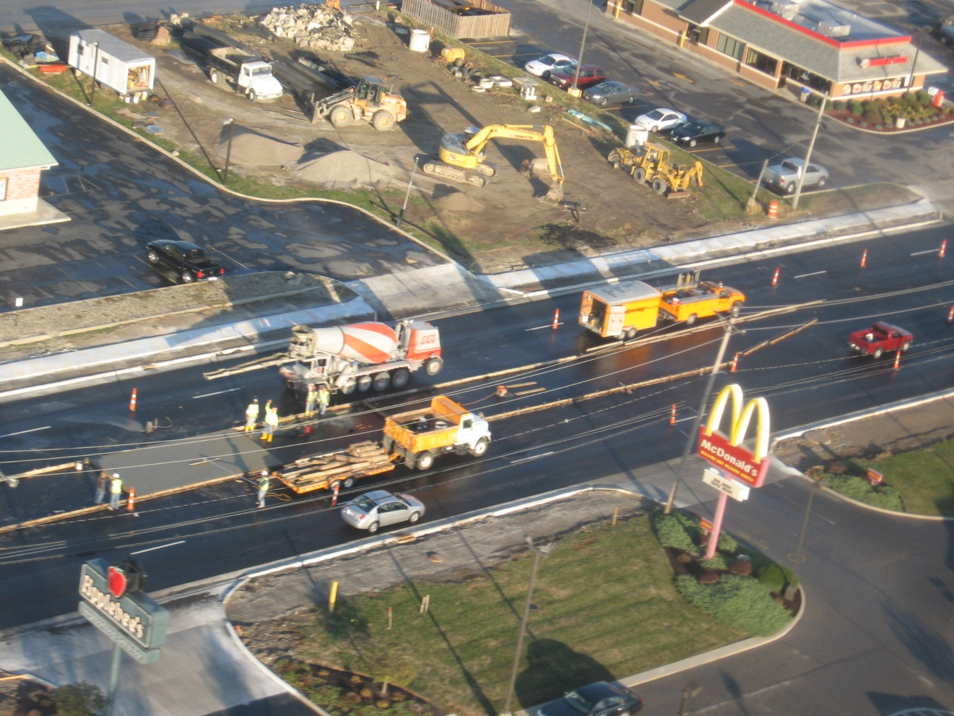
DEF-66-7.37

Slide 19
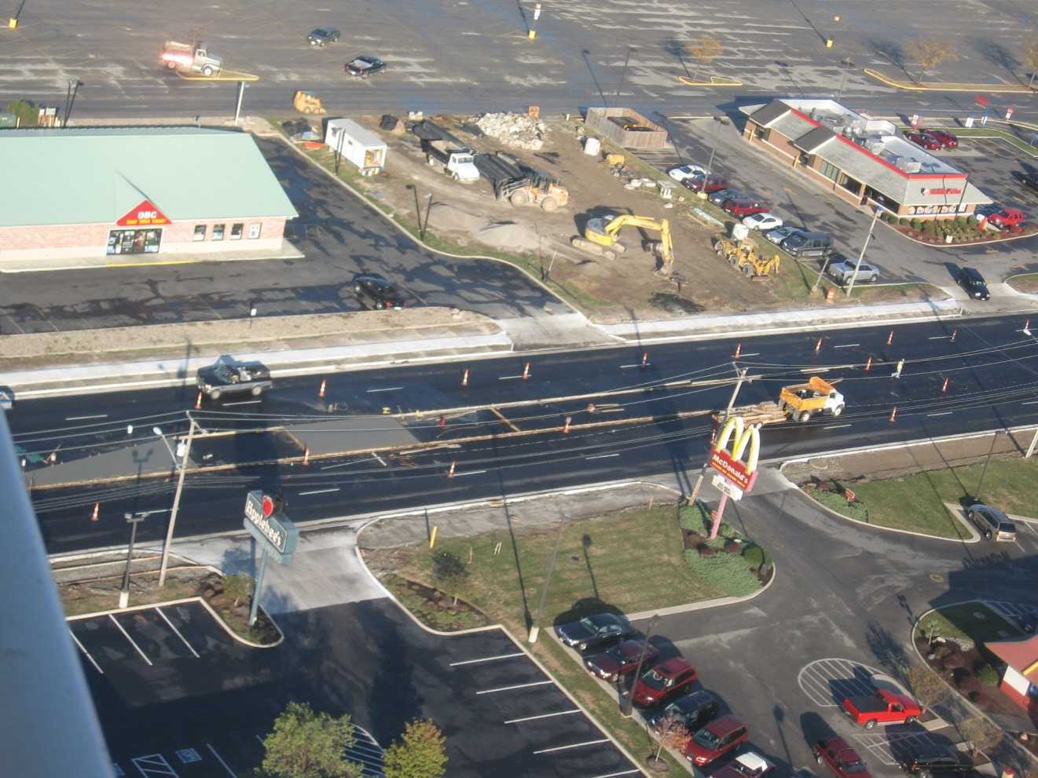
DEF-66-7.37

Slide 20
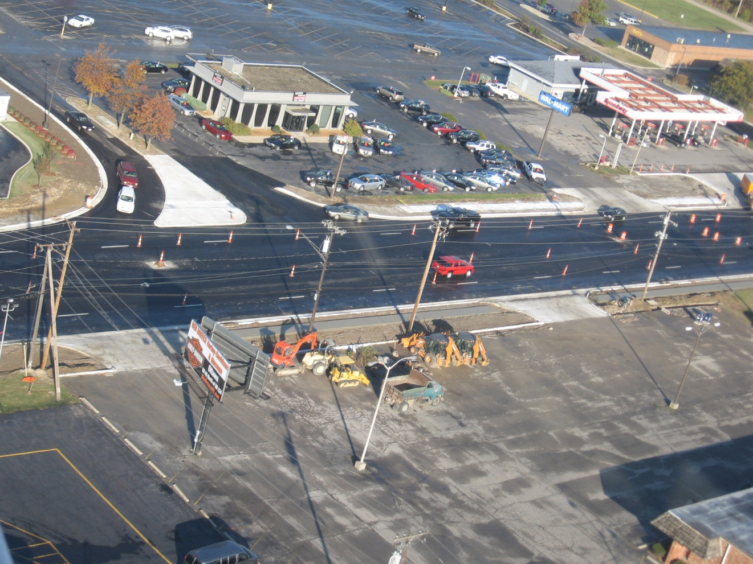
DEF-66-7.37

Slide 21
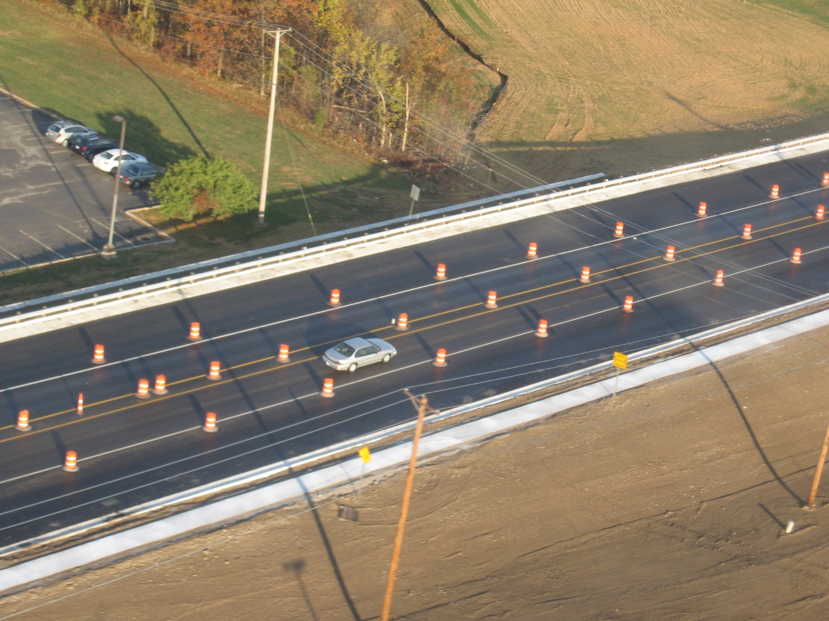
DEF-66-7.37

Slide 22
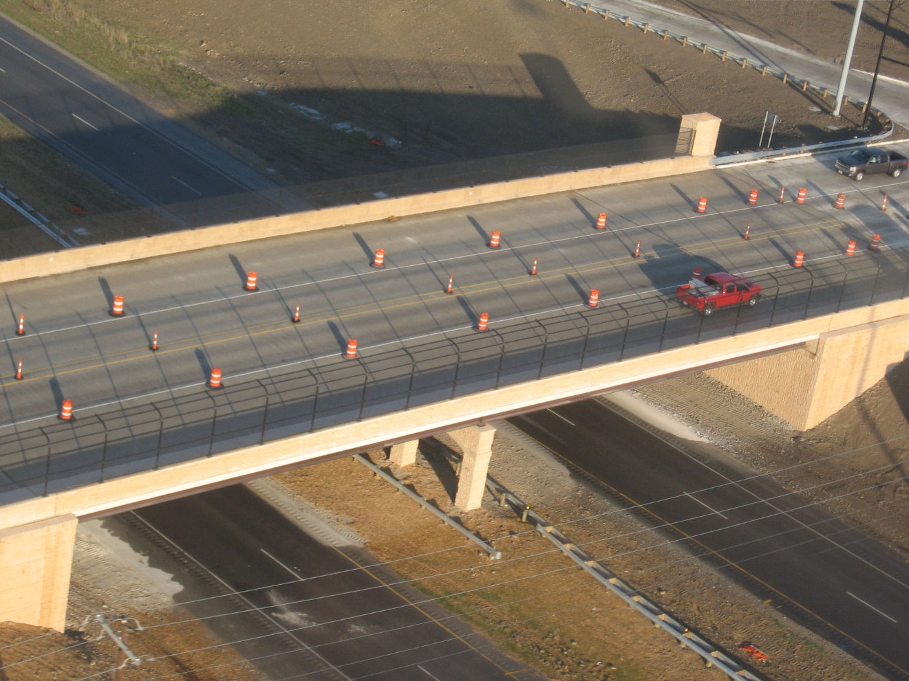
DEF-66-7.37

Slide 23
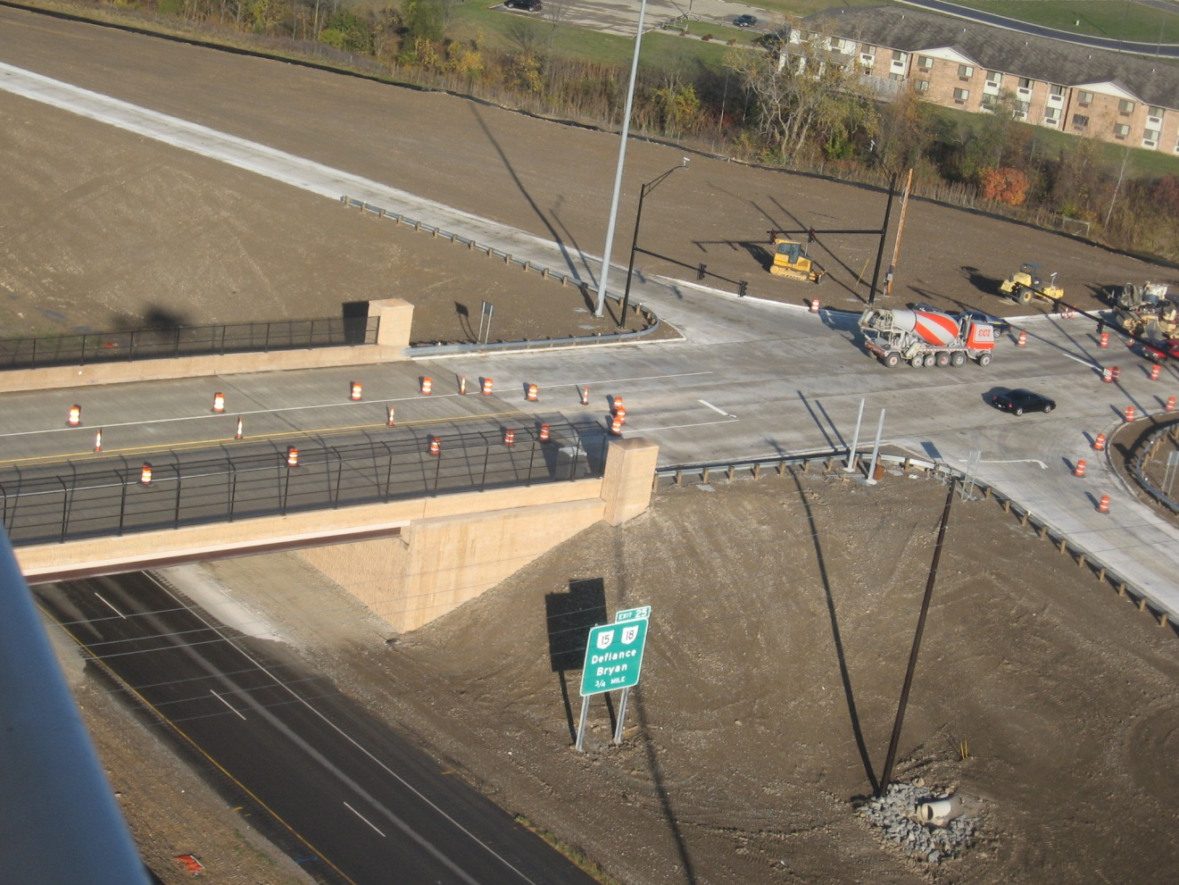
DEF-66-7.37

Slide 24
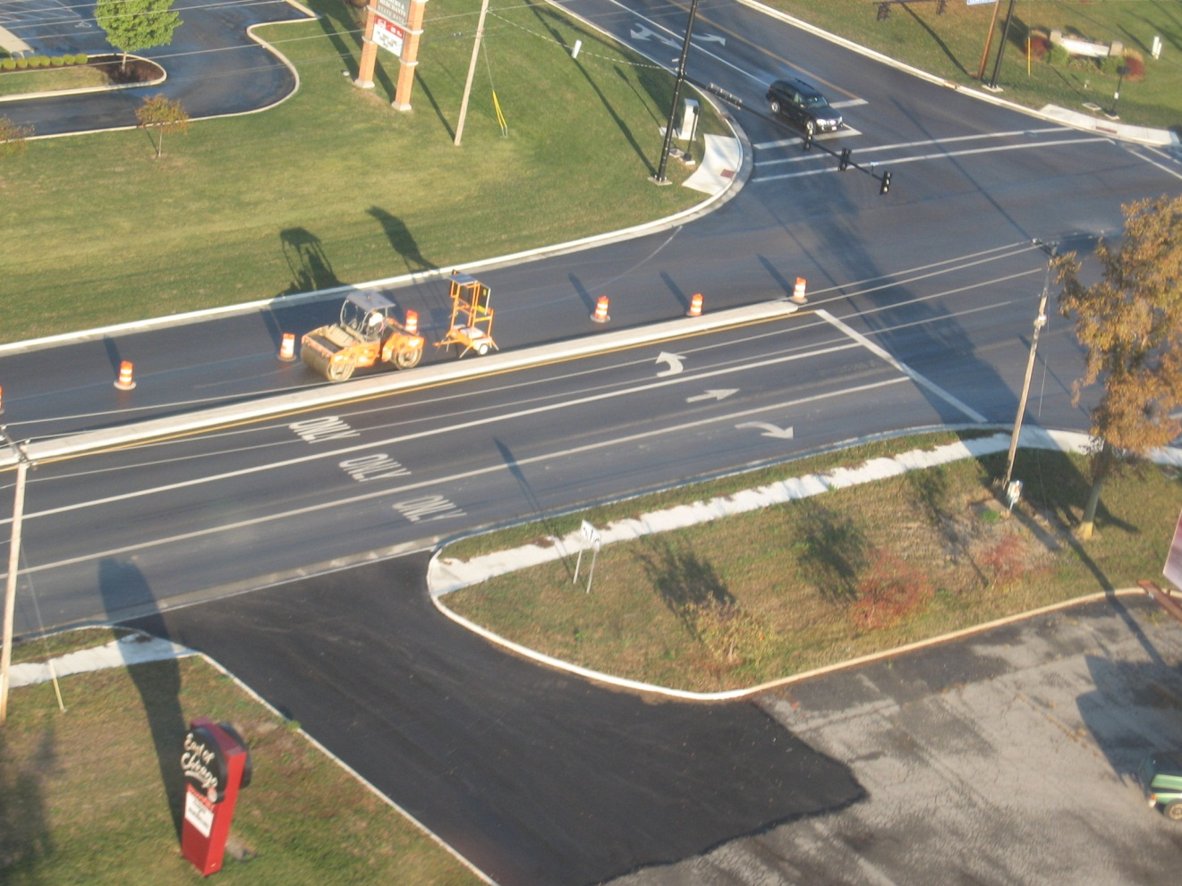
DEF-66-7.37

Slide 25
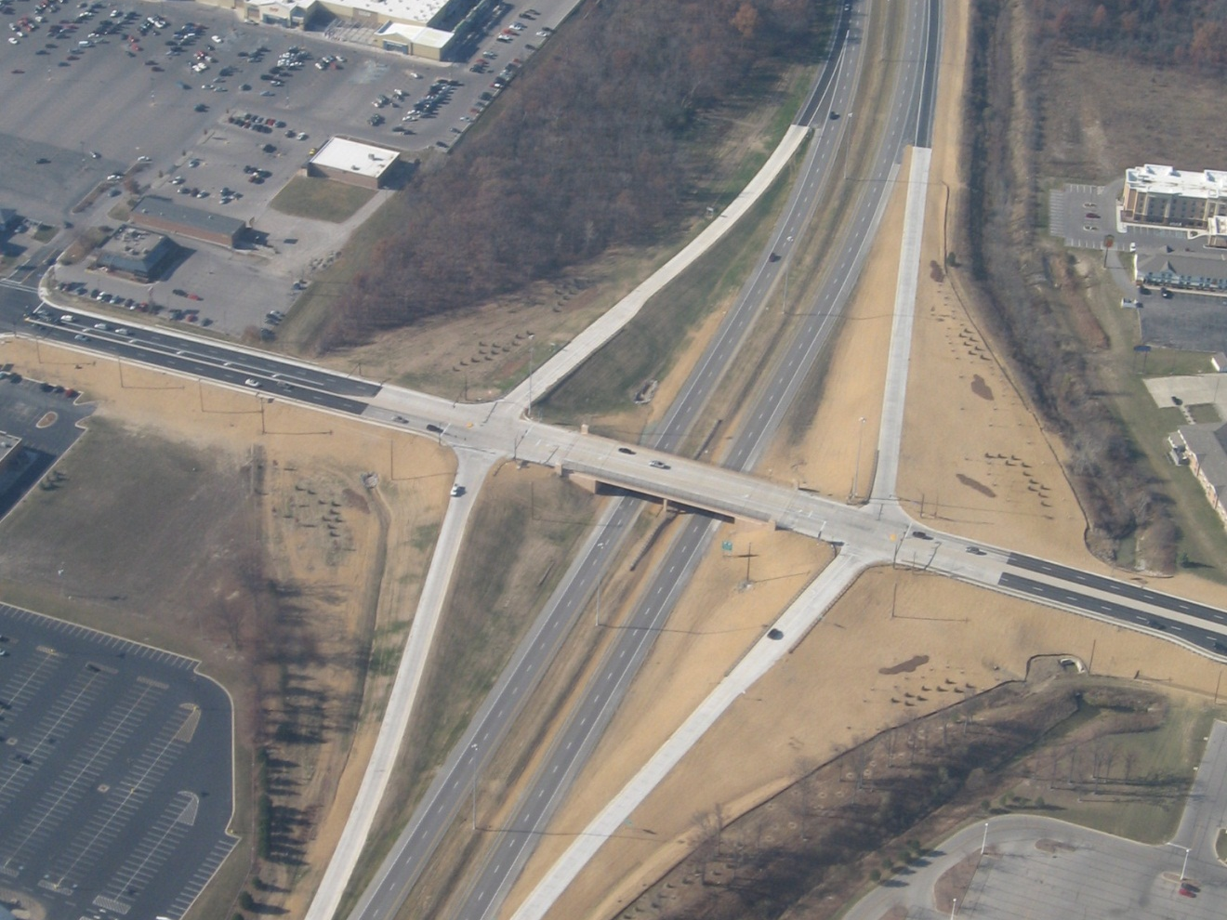
DEF-66-7.37

Slide 26
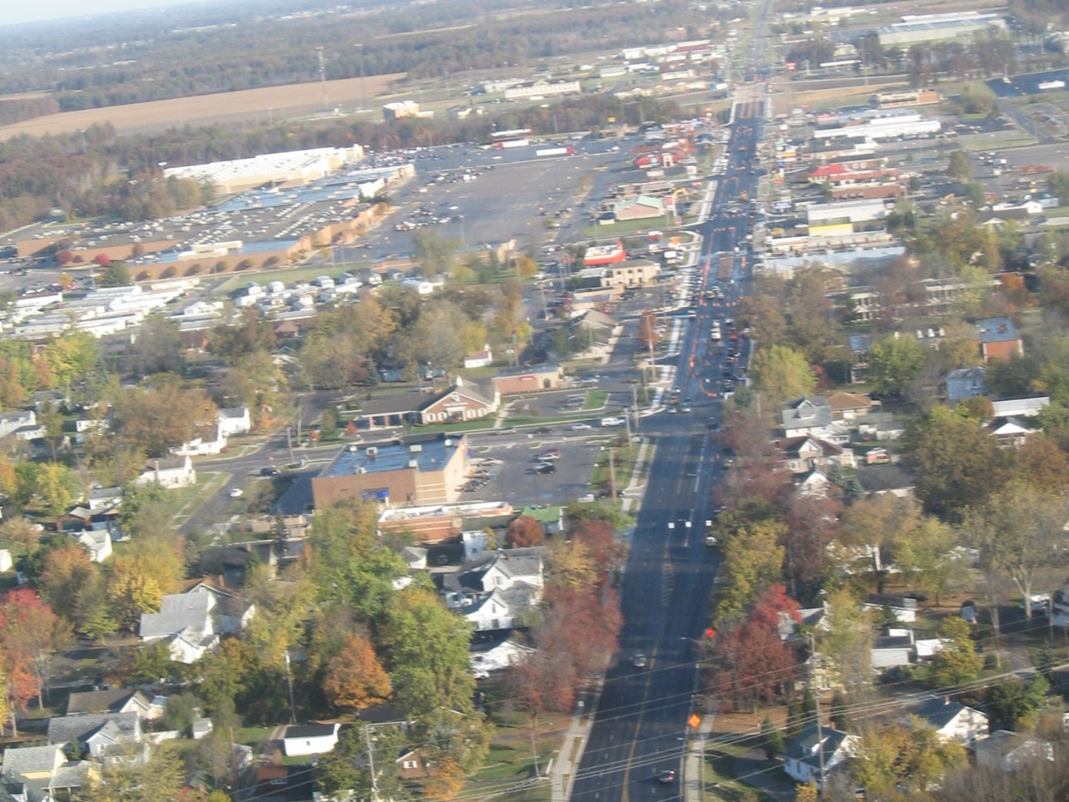
DEF-66-7.37

Slide 27
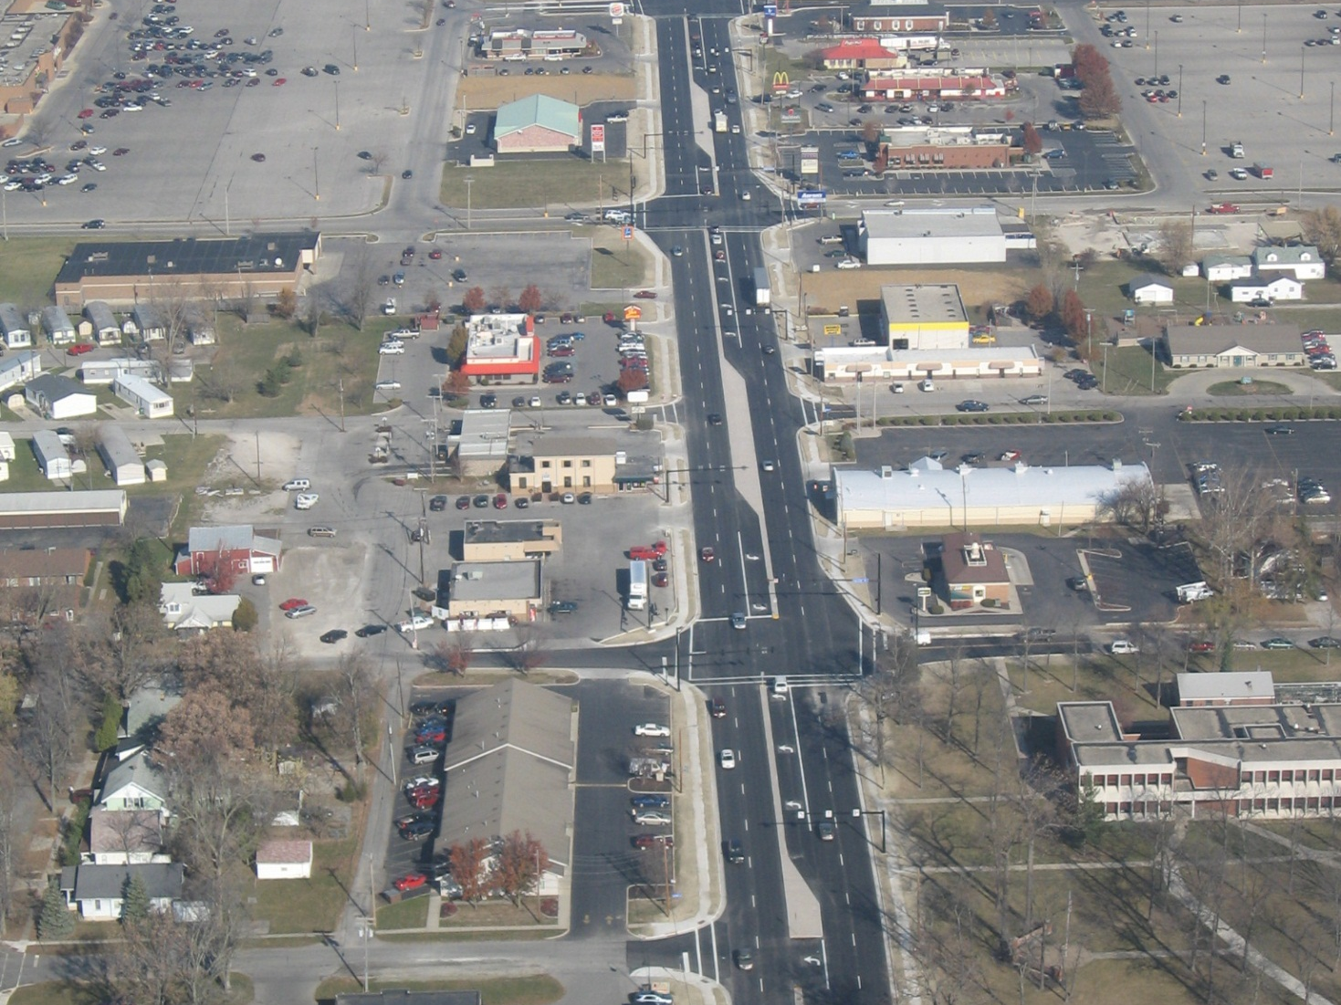
DEF-66-7.37

Slide 28
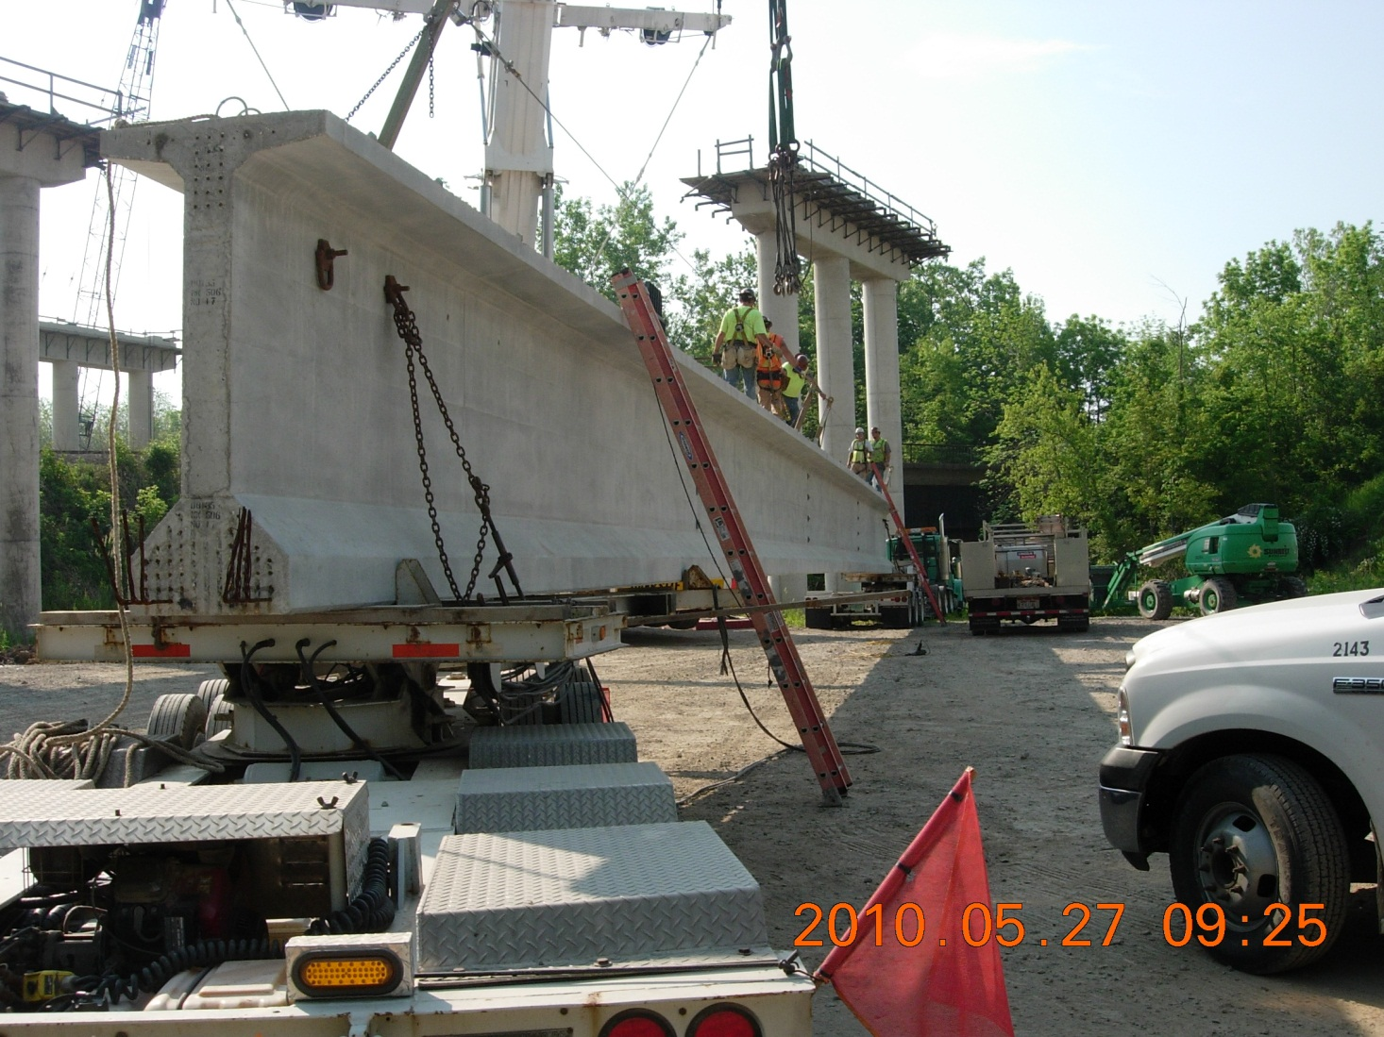
HEN-24-10.74

Slide 29
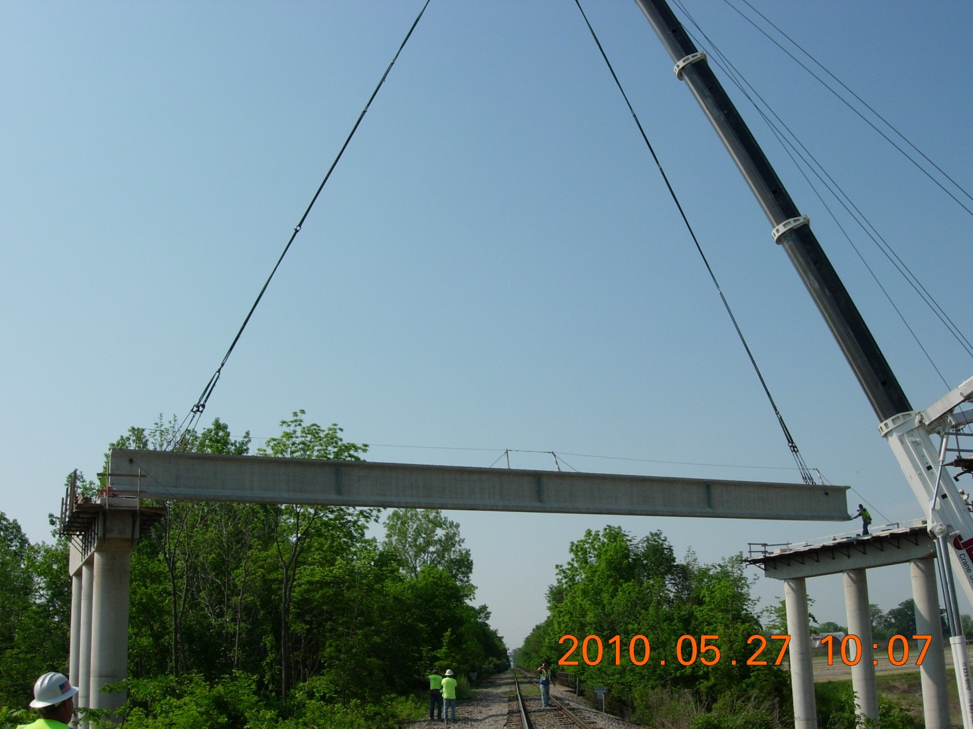
HEN-24-10.74

Slide 30
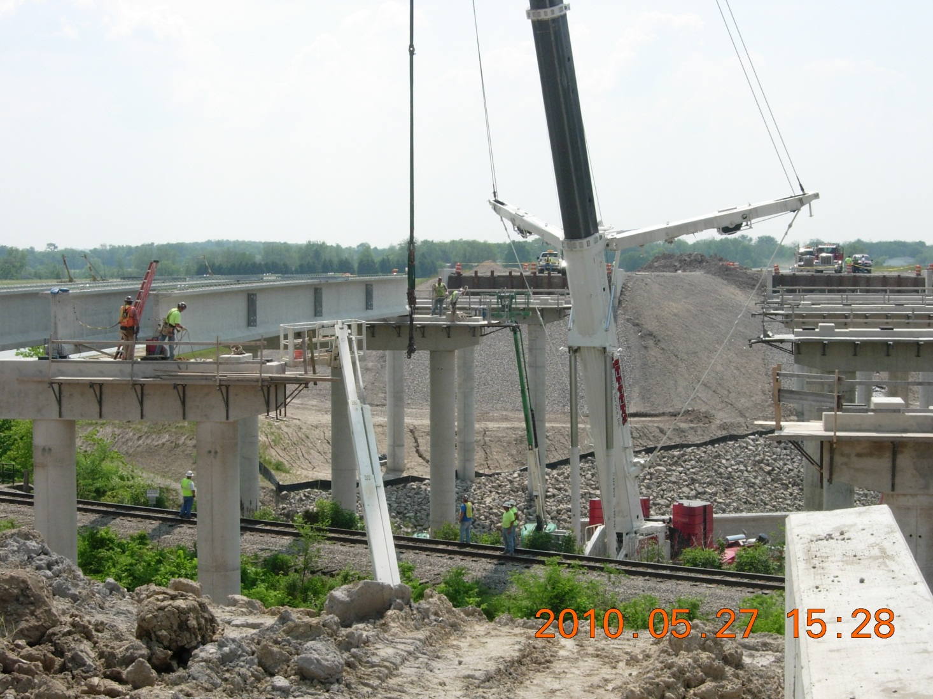
HEN-24-10.74

Slide 31
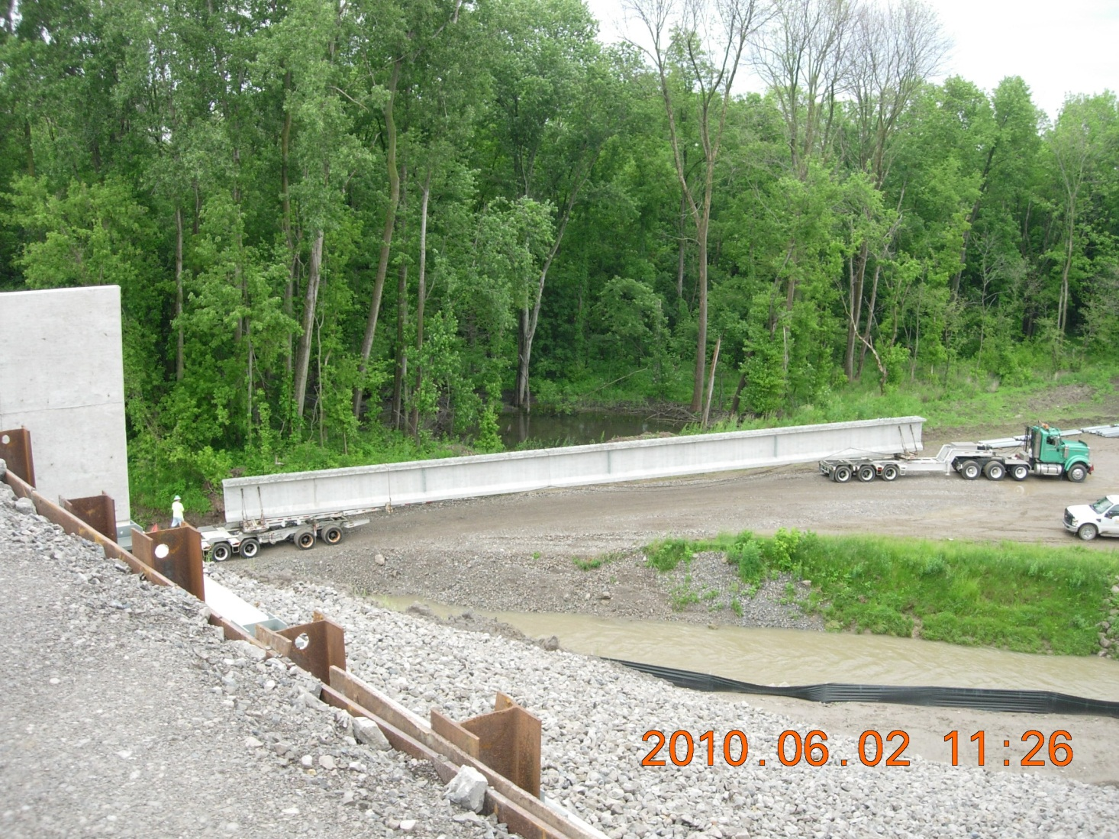
HEN-24-10.74

Slide 32
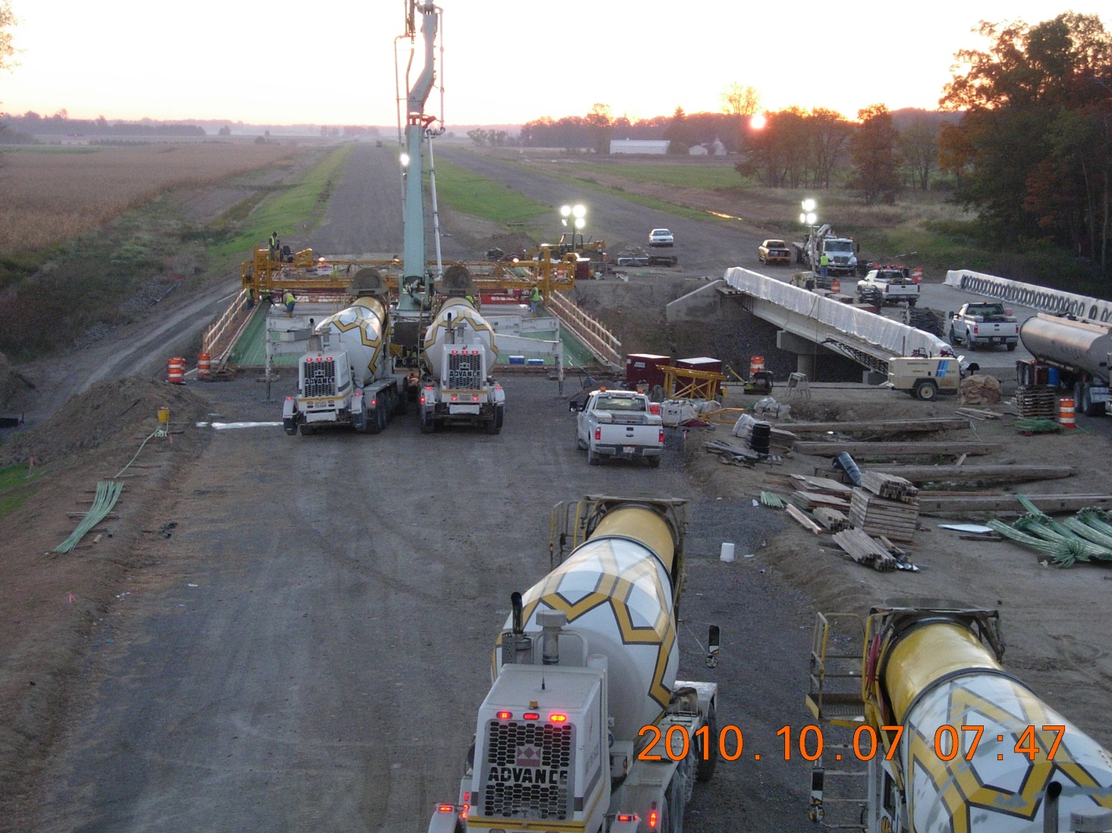
HEN-24-10.74

Slide 33
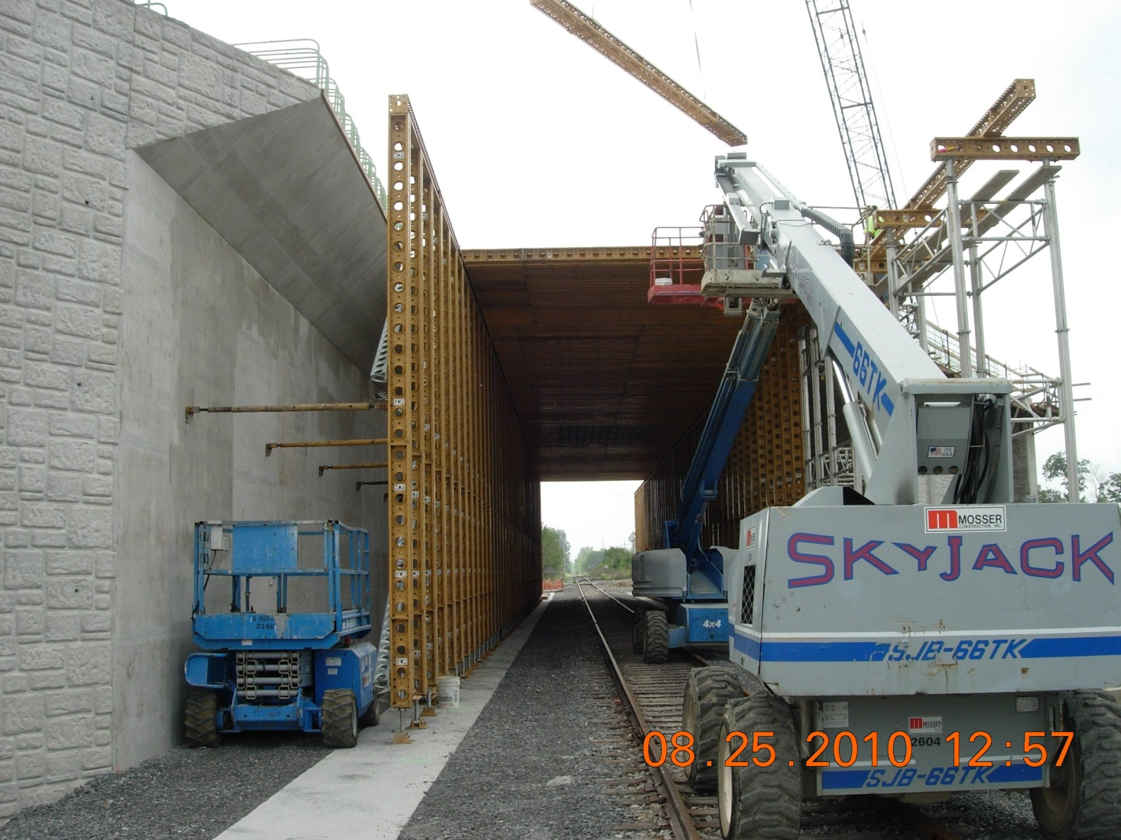
LUC US-24 006.19

Slide 34
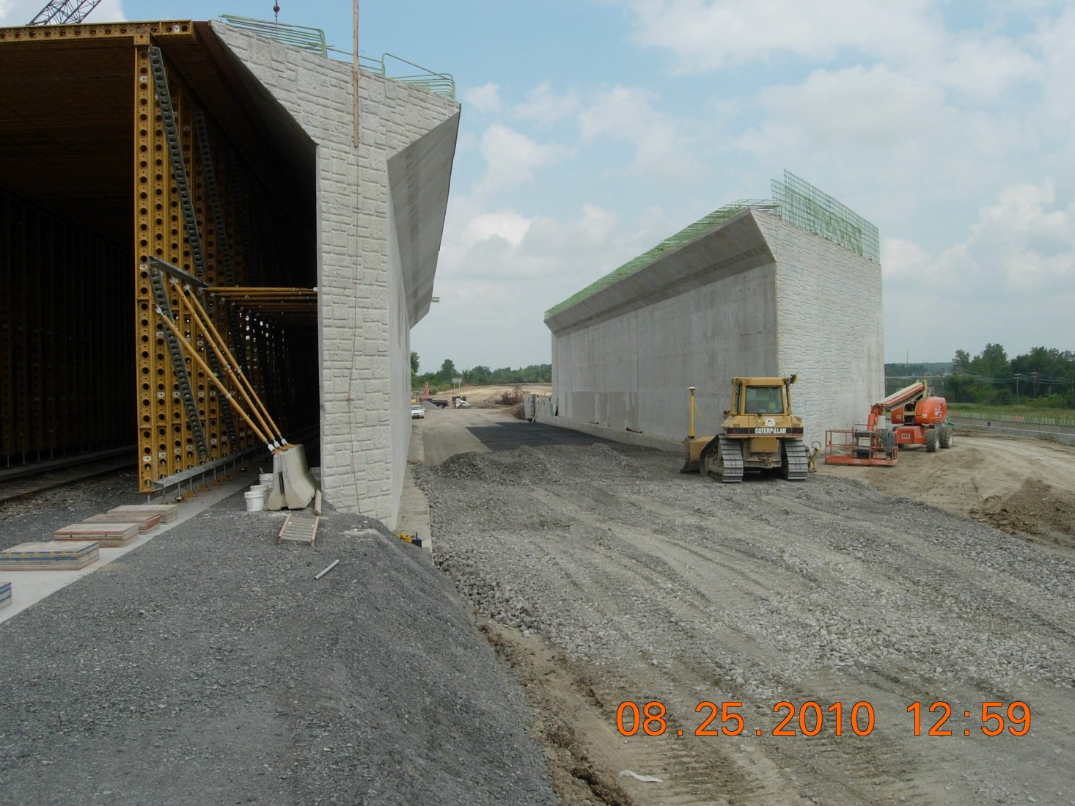
LUC US-24 006.19

Slide 35
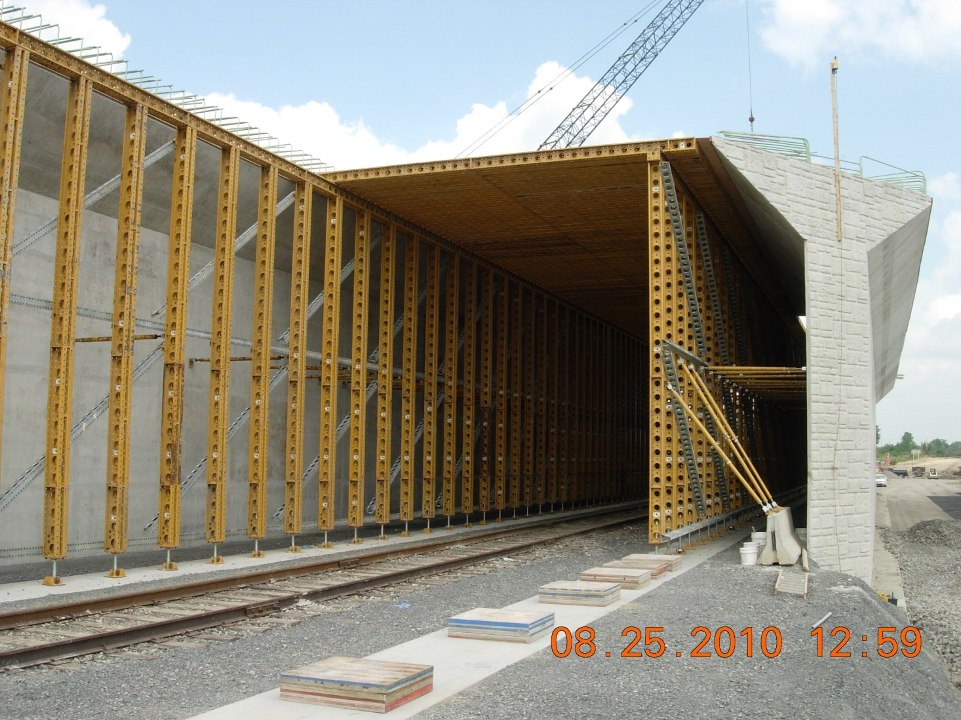
LUC US-24 006.19

Slide 36
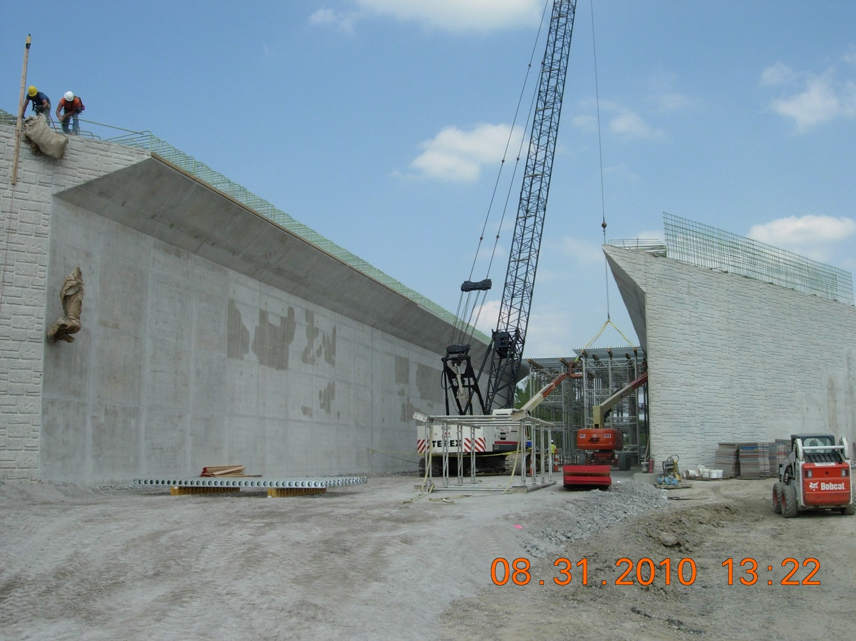
LUC US-24 006.19

Slide 37
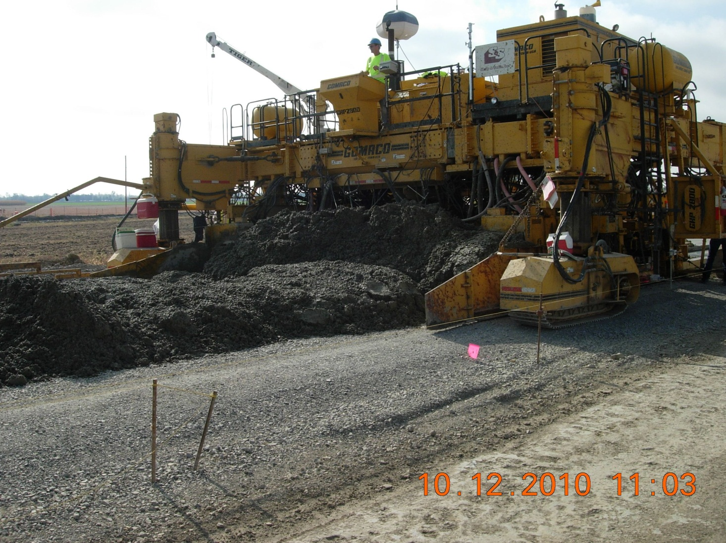
LUC US-24 006.19

Slide 38
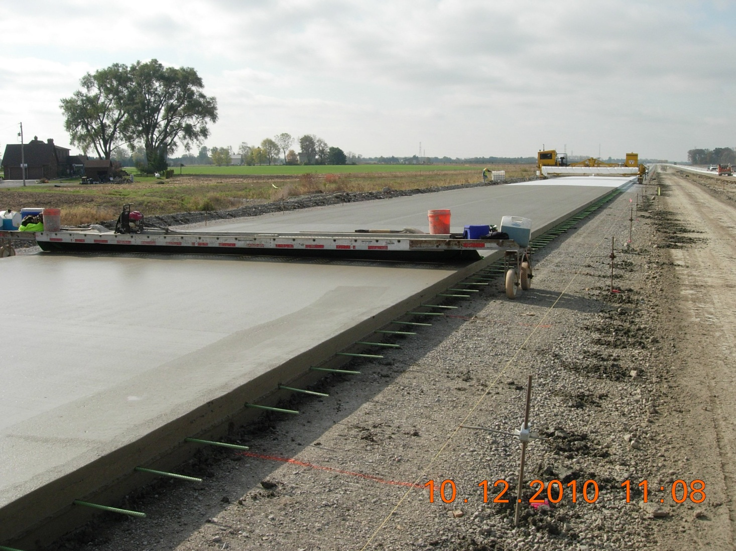
LUC US-24 006.19

Slide 39
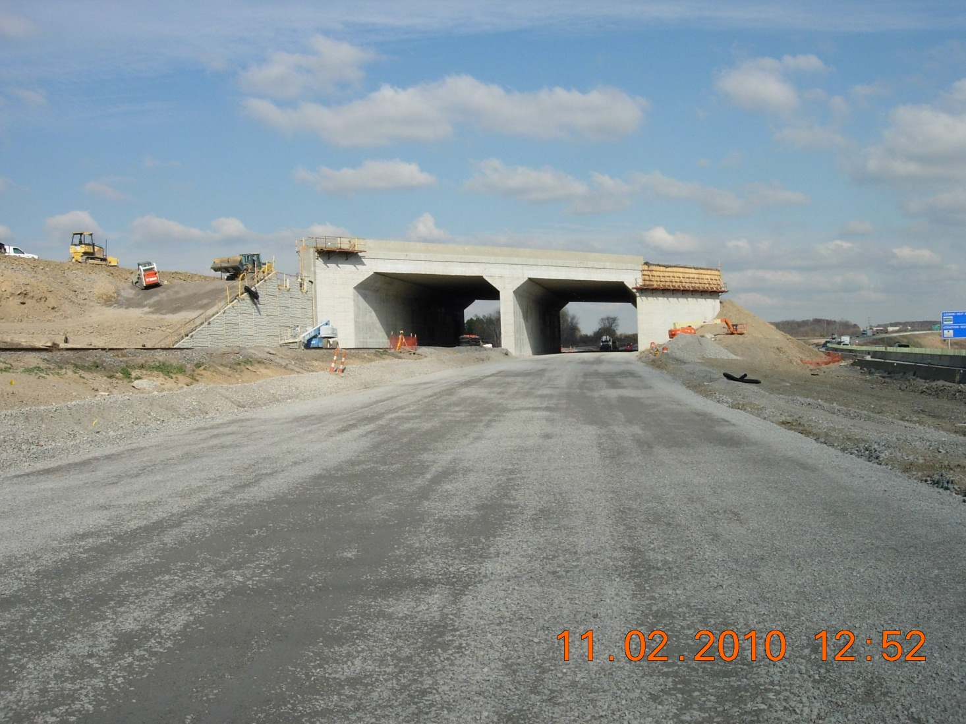
LUC US-24 006.19

Slide 40
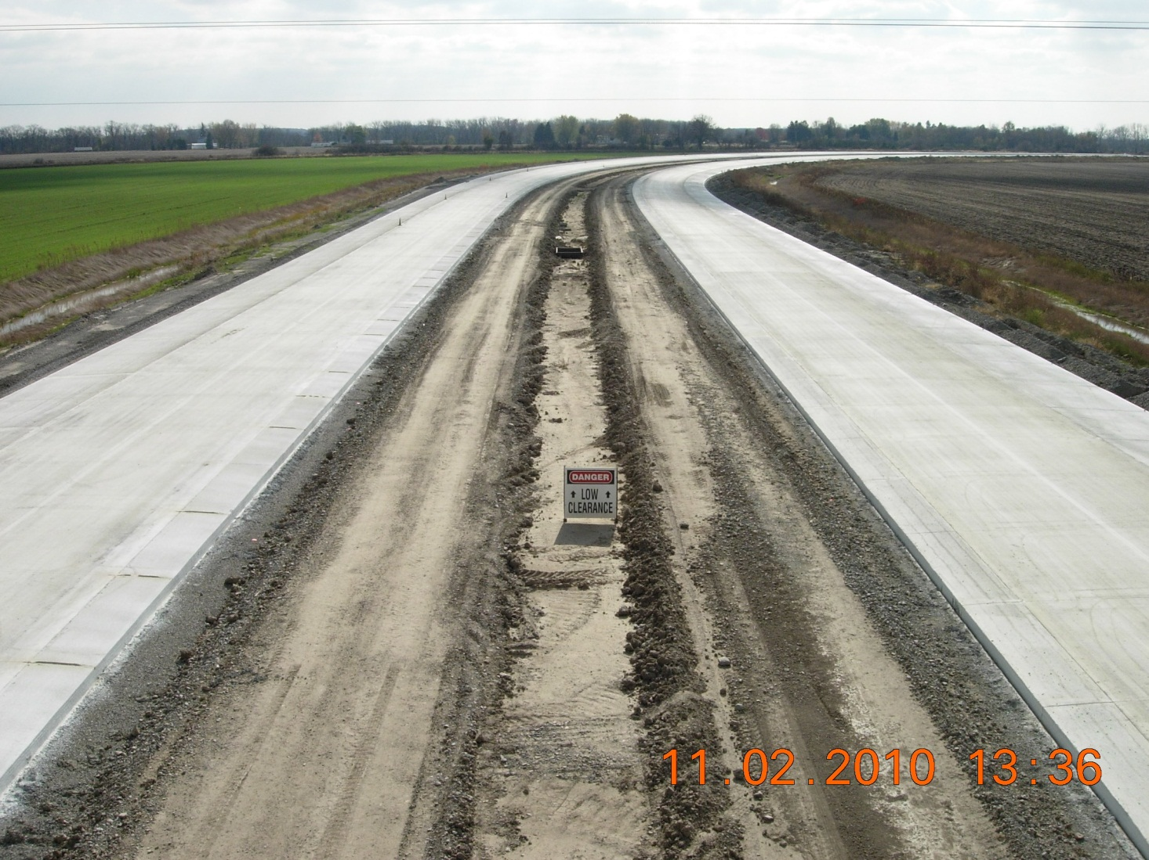
LUC US-24 006.19

Slide 41
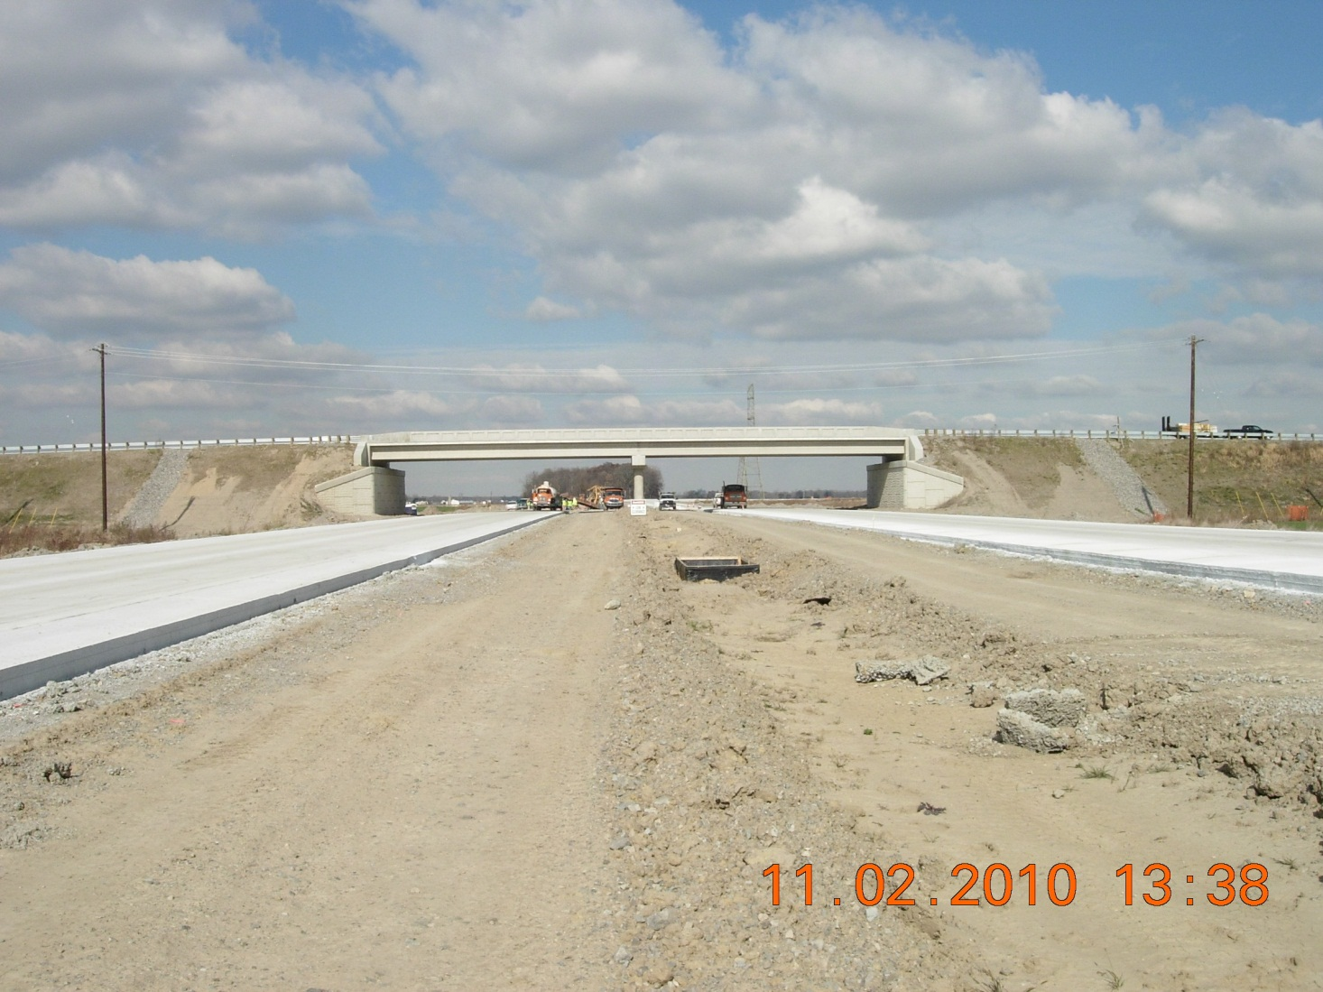
LUC US-24 006.19

Slide 42
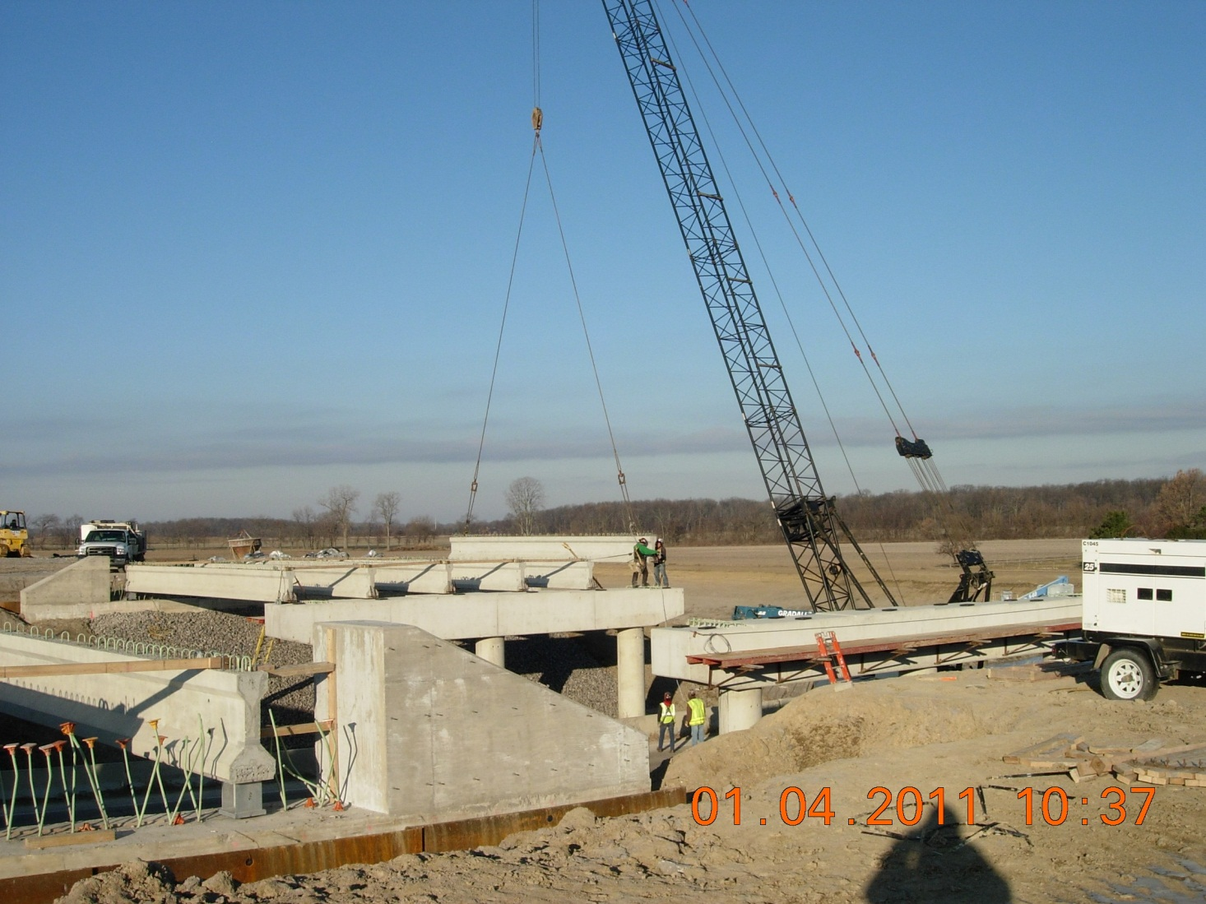
LUC US-24 006.19

Slide 43
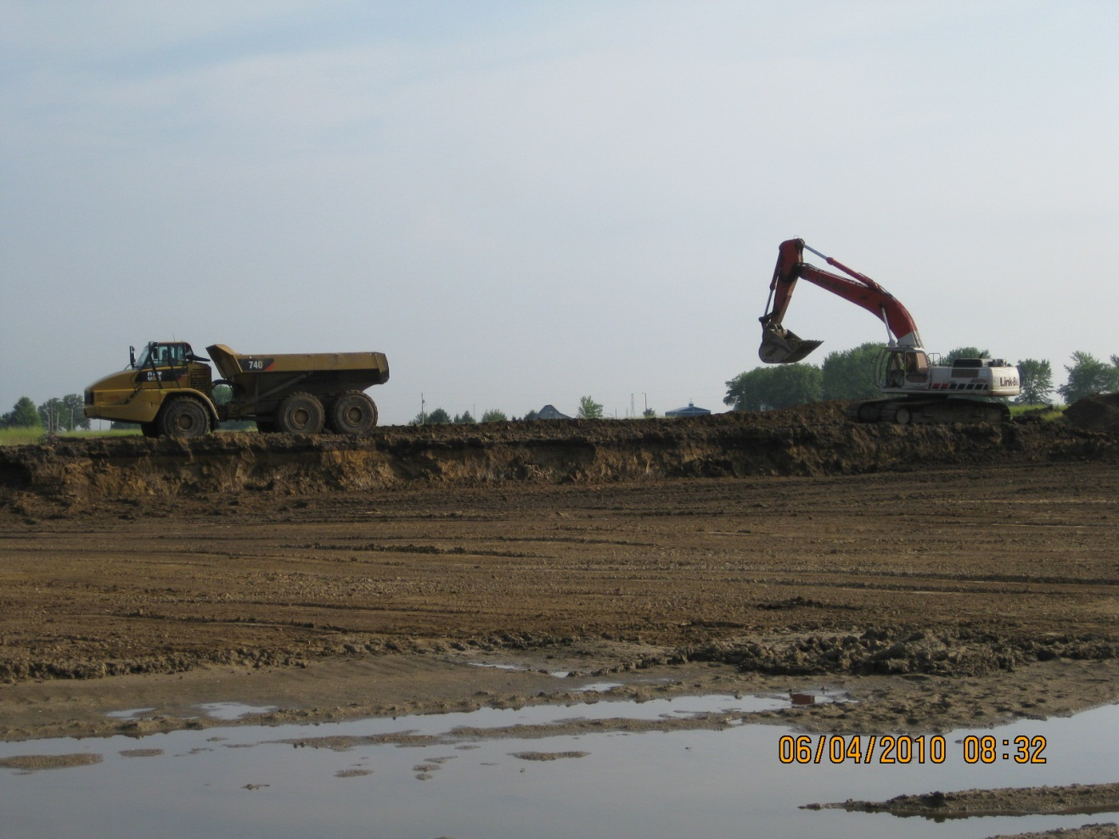
HEN/LUC-24-15.850.00

Slide 44
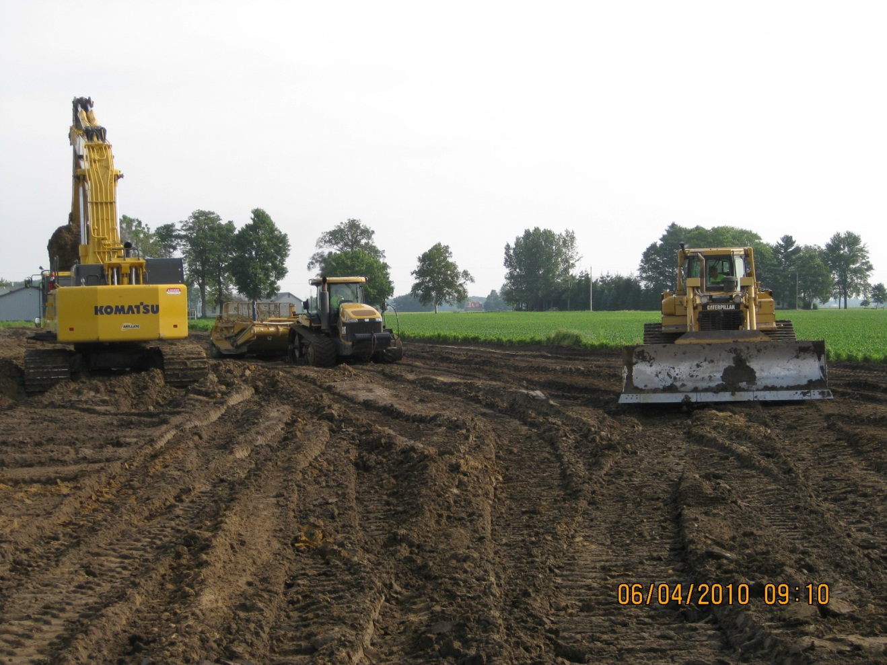
HEN/LUC-24-15.850.00

Slide 45
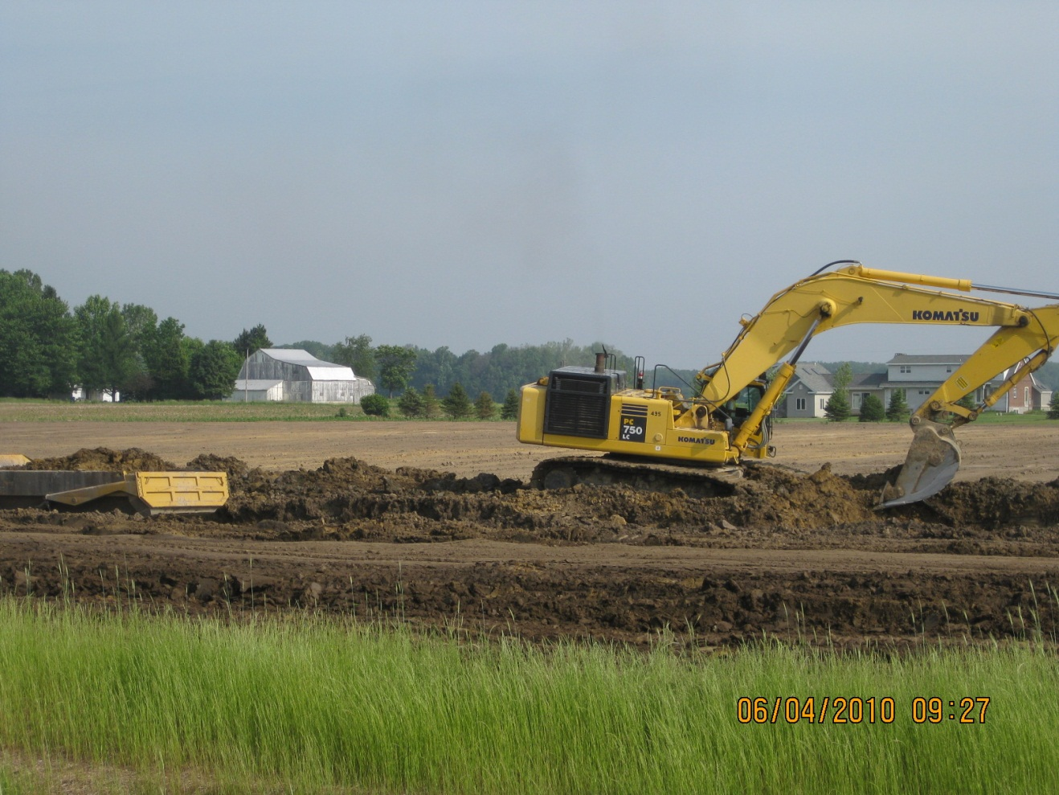
HEN/LUC-24-15.850.00

Slide 46
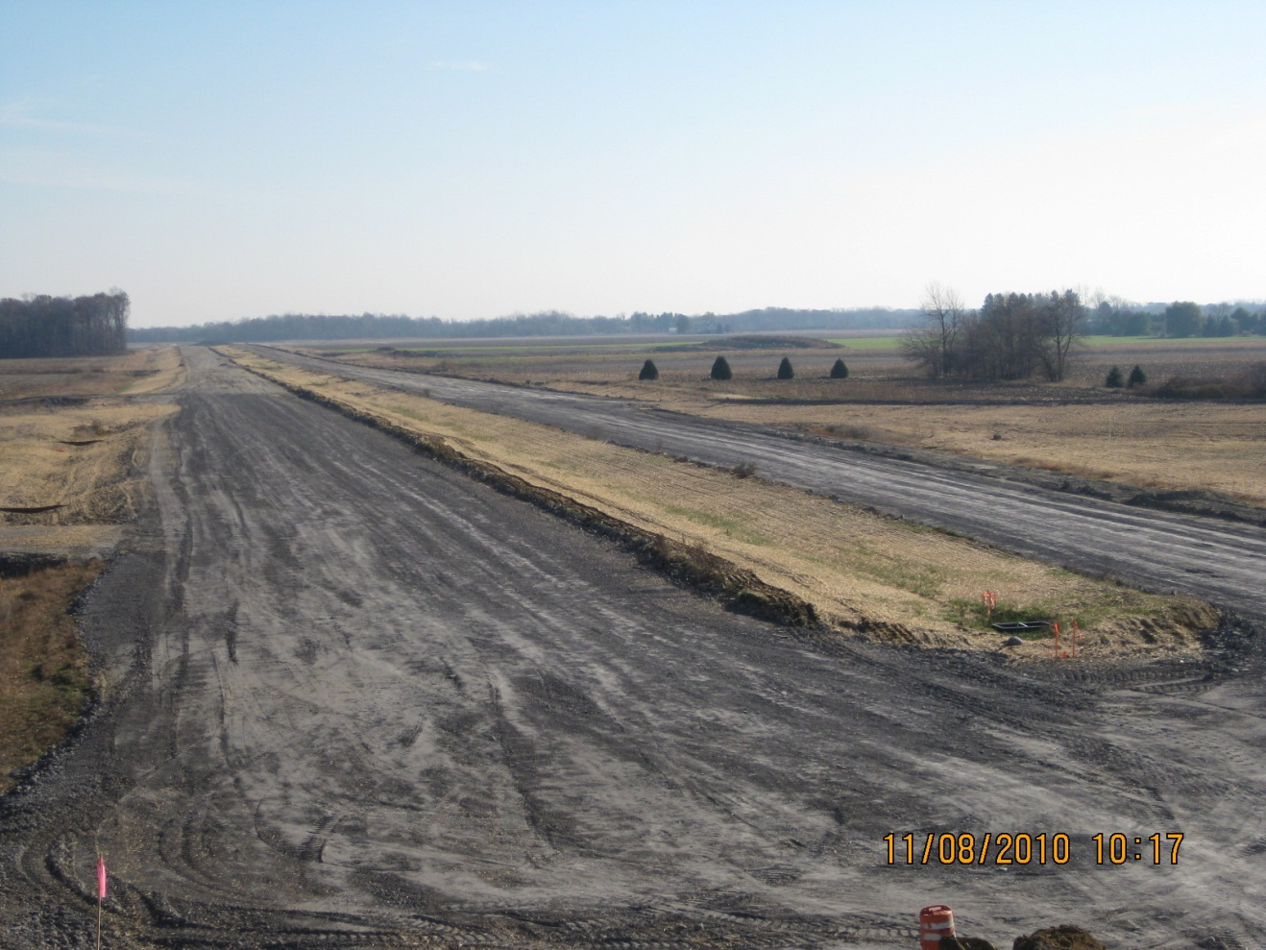
HEN/LUC-24-15.850.00

Slide 47
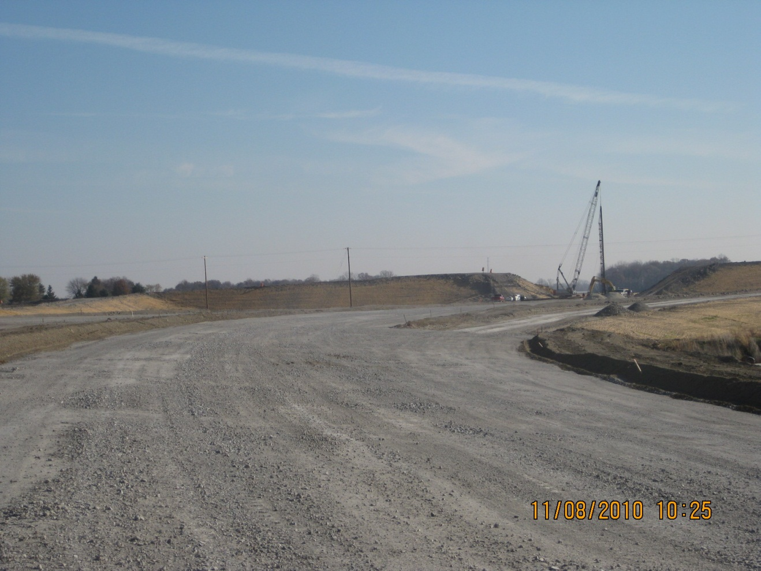
HEN/LUC-24-15.850.00

Slide 48
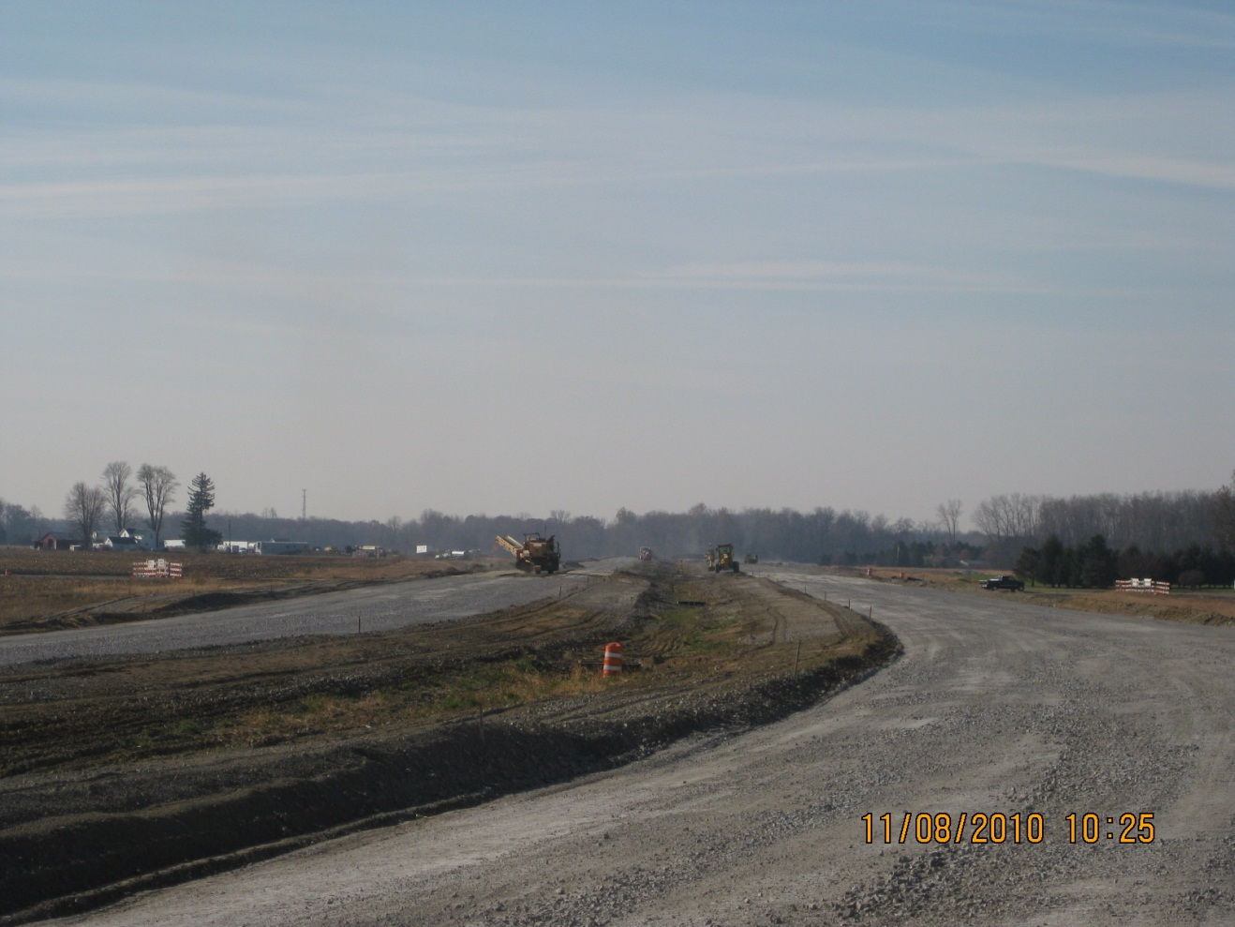
HEN/LUC-24-15.850.00

Slide 49
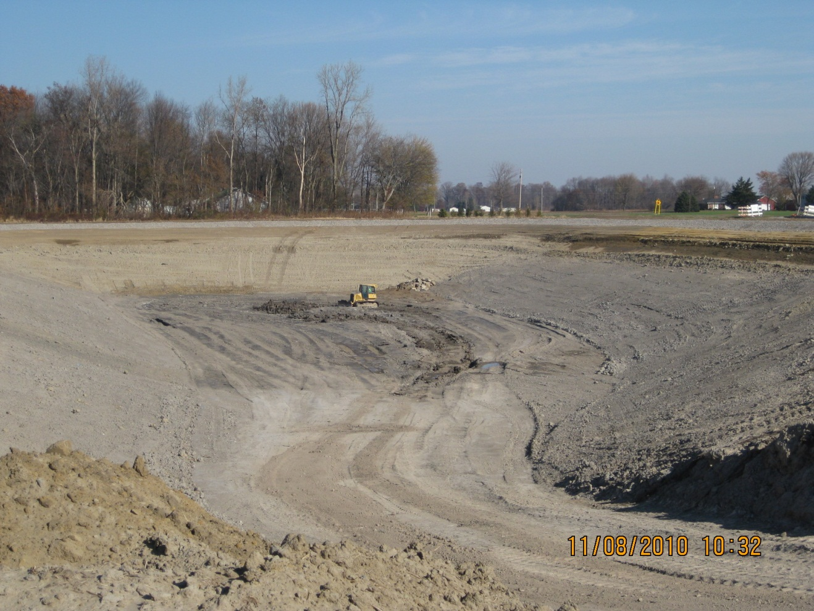
HEN/LUC-24-15.850.00

Slide 50
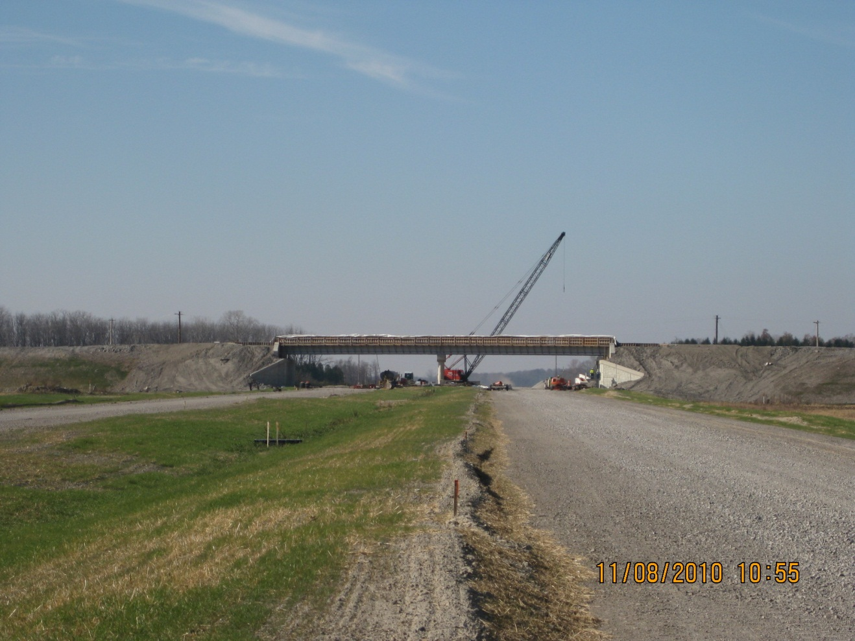
HEN/LUC-24-15.850.00

Slide 51
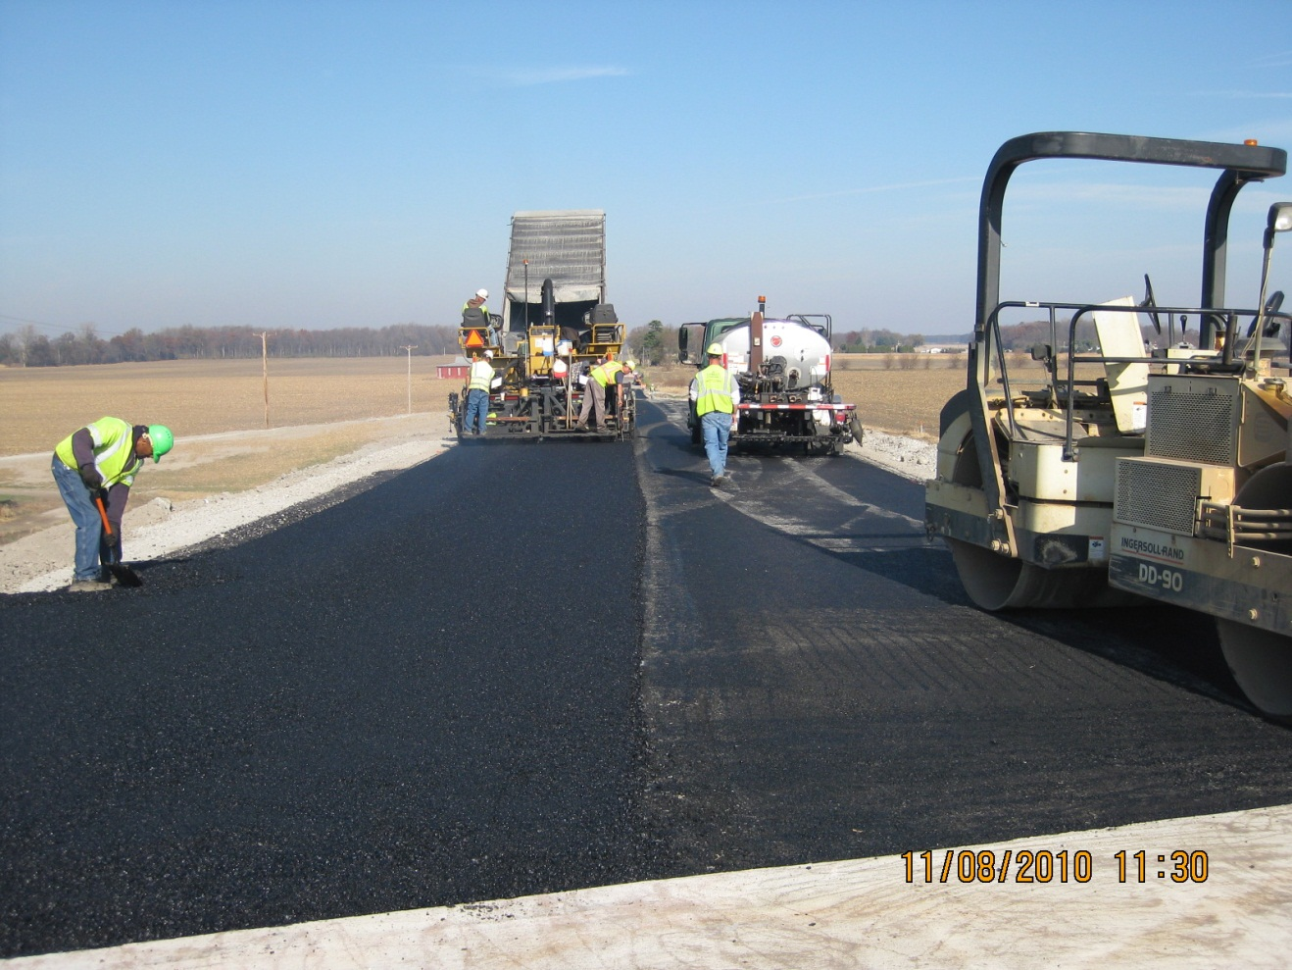
HEN/LUC-24-15.850.00

Slide 52

HEN/LUC-24-15.850.00

Slide 53

HEN/LUC-24-15.850.00

Slide 54

HEN/LUC-24-15.850.00

Slide 55

HEN/LUC-24-15.850.00

Slide 56

HEN/LUC-24-15.850.00

Slide 57

MOT-75-13.11

Slide 58

MOT-75-13.11

Slide 59

MOT-75-13.11

Slide 60

MOT-75-13.11

Slide 61

MOT-75-13.11

Slide 62

MOT-75-13.11

Slide 63

MOT-75-13.11

Slide 64

MOT-75-13.11

Slide 65

MOT-75-13.11

Slide 66

MOT-75-13.11

Slide 67

MOT-75-13.11

Slide 68

MOT-75-13.11

Slide 69

MOT-75-13.11

Slide 70

MOT-75-13.11

Slide 71

MOT-75-13.11

Slide 72

MOT-75-13.11

Slide 73

MOT-75-13.11

Slide 74

MOT-75-13.11

Slide 75

MOT-75-13.11

Slide 76

MOT-75-13.11

Slide 77

MOT-75-13.11

Slide 78

MOT-75-11.01

Slide 79

MOT-75-11.01

Slide 80

MOT-75-11.01

Slide 81

MOT-75-11.01

Slide 82

MOT-75-11.01

Slide 83

MOT-75-11.01

Slide 84

MOT-75-11.01

Slide 85

MOT-75-11.01

Slide 86

MOT-75-11.01

Slide 87

MOT-75-11.01

Slide 88

ATH US-33 015.05

Slide 89

ATH US-33 015.05

Slide 90

ATH US-33 015.05

Slide 91

MEI SR-124 056.02

Slide 92

MEI SR-124 056.02

Slide 93

MEI SR-124 056.02

Slide 94

MEI SR-124 056.02

Slide 95

HOC US-33 019.89

Slide 96

HOC US-33 019.89

Slide 97

HOC US-33 019.89

Slide 98

HOC US-33 019.89

Slide 99

HOC US-33 019.89

Slide 100

HOC US-33 019.89

Slide 101

HOC US-33 019.89

Slide 102

HOC US-33 019.89

Slide 103

HOC US-33 019.89

Slide 104

HOC US-33 019.89

Slide 105

HOC US-33 019.89

Slide 106

HOC US-33 019.89

Slide 107

HOC US-33 016.52

Slide 108

HOC US-33 016.52

Slide 109

HOC US-33 016.52

Slide 110

HOC US-33 016.52

Slide 111

HOC US-33 016.52

Slide 112

FRA SR-315 002.40

Slide 113

FRA SR-315 002.40

Slide 114

FRA SR-315 002.40

Slide 115

FRA SR-315 002.40

Slide 116

FRA SR-315 002.40

Slide 117

FRA SR-315 002.40

Slide 118

FRA SR-315 002.40

